Slide 1
Exploring the Use of Machine Learning and Natural Language Processing Techniques for Fake News Detection on Reddit
Ashritha Kumari , Dhrumil Shah, Prudhvi Ch, Shashank Reddy

Slide 2
Index
Abstract
Introduction
1.1 Project Background and Execute Summary
1.2 Project Requirements
1.3 Project Deliverables
1.4 Technology and Solution Survey
1.5 Literature Survey of Existing Research
Data and Project Management Plan
2.1 Data Management Plan
2.2 Project Development Methodology
2.3 Project Organization Plan
2.4 Project Resource Requirements and Plan
2.5 Project Schedule

Slide 3
Index
Data Engineering
3.1 Data Process
3.2 Data Collection
3.3 Data Pre-processing
3.4 Data Transformation
3.5 Data Preparation
3.6 Data Statistics
Model Development
4.1 Model Proposals
4.2 Model Supports
4.3 Model Comparison and Justification
4.4 Model Evaluation Methods

Slide 4
Abstract

Slide 5
Abstract
1. Issue Recognition and Significance - Acknowledges the pervasive and disruptive nature of fake news in the digital age, emphasizing its potential fatal consequences for individuals and society.
2. Project Objective - Aims to conduct a comprehensive comparative analysis of machine learning algorithms for detecting fake news, involving data collection, preprocessing, and training/testing models on Reddit posts with features like retweets, image_text, and title.
3. Algorithmic Approach - Utilizes NLP for sentiment analysis, employs spacy for feature embedding, and trains the model using a diverse set of classification algorithms such as, Random Forests, Naïve Bayes, Decision Tree, SVM, Logistic Regression..
4. Evaluation Metrics and Model Efficiency - Assesses model efficiency using various evaluation metrics, including confusion matrix, Accuracy, F1-score, Recall, Precision with the goal of determining the best-performing model for classifying posts.
5. Application and Future Scope - Envisions practical application in filtering out fake news on Reddit, emphasizing the project's potential impact in preventing misinformation and suggesting future implementation for flagging misleading accounts.
Notes:
There is no doubt that fake news has become a pervasive and disruptive issue in the digital age, with the potential to have fatal consequences for individuals as well as society. Detecting fake news is a critical task that has drawn the attention of researchers and practitioners alike. The objective of this machine learning project is to provide a thorough comparative analysis of various machine learning algorithms to determine which of them performs best when it comes to the challenging task of detecting fake news. Proposed model flow consists of Data Collection, Data Preprocessing, Model Training and Testing the model. Tweets and features consisting of but not limited to no. of likes, retweets, syllables, words will be collected using Reddit API. Data preprocessing uses NLP to determine a tweets sentiment and employs BERT / spacy for feature embedding and model will be trained on different classification algorithms like XGboost, Random Forests, Naïve Bayes, KNN, Decision Tree, SVM, Logistic Regression, ANN and LSTM. Efficiency of model can be determined using various evaluation metrics such as confusion matrix, Accuracy, F1-score, AUC-ROC (Area under the Receiver Operating Characteristic curve), Recall, Precision, Probability threshold and Log Loss. Comparison of these evaluation metrics for each proposed model will define the best model in classifying the posts. The model developed in this project can be used to filter out fake news on Twitter. Stopping people from being misled by misinformation and flagging those accounts can be implemented in the project’s future scope.

Slide 6
Introduction

Slide 7
1.1 Project Background
1. Reddit Significance: With over 430 million monthly users and 100,000 active communities, Reddit is a globally influential social network, generating 830,000 daily posts. The prevalence of fake news on Reddit poses a significant societal risk, especially in political contexts.
2. Project Need and Importance: The project addresses the critical need to combat the escalating generation of fake news, emphasizing the potential severe consequences on a national and global scale. Unchecked, fake news can incite discord, disrupt economies, damage reputations, and erode public trust in government.
3. Proposed Model Flow: The project outlines a comprehensive model flow, encompassing data collection through Reddit's "PRAW" API, preprocessing involving natural language processing and feature embedding, and model training/testing/evaluation. Features include post-related data such as title, author, shares, likes, subreddits, and upvote ratio.
4. Diverse Classification Techniques: The model incorporates various classification techniques, including Random Forests, Naive Bayes, Decision Trees, SVM, Logistic Regression. Natural language processing and spacy embeddings enhance feature extraction.
5. Evaluation Metrics: Multiple assessment metrics, including confusion matrix, accuracy, F1-score, Recall, and Precision, will be utilized to gauge model effectiveness. The selection of the best-performing model for identifying fake Reddit posts will be based on a comprehensive comparison of these evaluation metrics.
Notes:
With more than 430 million monthly active users and over 100,000 active communities, Reddit is ranked among the most popular social networks worldwide. Reddit generates nearly 830,000 posts per day. Of which there are several posts which are fake. Fake news can have a significant impact on society, especially in the context of politics. The need, motivation, importance of doing this project is that fake news generation is increasing day-by--day. It can cause a lot of damage nationally and globally. It can incite individuals and races and if not controlled can lead to massive chaos which has the power to disrupt the country's reputation, businesses, financials market, damaging economy of the country and people losing faith in government. The proposed model flow consists of data collection, data preprocessing, model training, model testing, and model evaluation. Using Reddit's "PRAW" API, features such as title, author, posts, number of shares, likes, subreddits, and upvote ratio are collected. The model will be trained using a variety of classification techniques, including XGboost, Random Forests, Nave Bayes, KNN, Decision Trees, SVM, Logistic Regression, ANN and LSTM. During data preprocessing, natural language processing is used to identify the sentiment of a post and BERT/spacy is used to embed features. Several assessment metrics can be used to evaluate the effectiveness of the model, including the confusion matrix, accuracy, F1-score, AUC-ROC (Area under Receiver Operating Characteristic curve), Recall and Precision. Based on the comparison of these evaluation metrics, the best model for determining whether Reddit postings are fake will be selected.

Slide 8
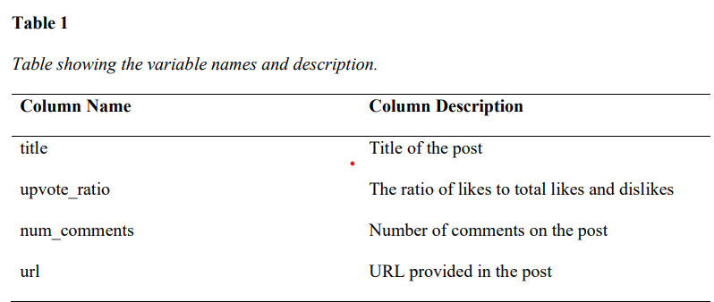
1.2 Project Requirements
Data Collection Using PRAW - Utilizes the Python Reddit API Wrapper (PRAW) to gather source and metadata information of user posts from various news-based subreddits such as "news," "Politics," "WorldNews," “nottheonion,” and "fakenews" through the Reddit API.
Dataset Characteristics - The collected data is saved in a comma-separated file with approximately 70,000 rows and 10 columns. The chosen columns for retention include "title," "upvote_ratio," "num_comments," "url," while the remaining columns are discarded.
Focus on Relevant Information - Emphasizes the importance of retaining specific columns such as post title, upvote ratio, image_text, self_text, and URL, streamlining the dataset to focus on key information relevant to the analysis or project goals.
Notes:
PRAW is used to collect post and metadata information from subreddits via Reddit API.
The data is saved in a file with 10,000 rows and 10 columns, focusing on "title," "upvote_ratio," "num_comments," and "url."
The dataset is streamlined to focus on key, relevant information.

Slide 9
1.2 Project Requirements (continued)
Labeling. The collected data from Reddit are unlabeled. The collected data must be manually identified and labeled as fake or real posts. The model’s prediction capabilities can be impacted by incorrect label.
Quality of posts. Data quality should be maintained for a good-performing model. The textual data gathered from user posts on Reddit must be contextually rich. There should be no null values or unclean text in the posts, duplicates.
Variable selection. We must ensure the required features or variables are extracted from the user posts. Needless features must be discarded from the dataset to ensure there is a clean dataset for implementation.
Variety of posts. An extensive range of posts including those with varying degrees of engagement must be evaluated and classified effectively by the model.
Notes:
Correct labeling of collected data as fake or real is essential for accurate model predictions.
Data quality should be maintained by ensuring contextually rich text with no null values or unclean text in posts.
Only necessary features/variables should be selected from user posts for a clean dataset.
The model must be able to effectively classify posts with varying degrees of engagement.

Slide 10
1.3 Project Deliverables
The project performs a comparative analysis of different classification algorithms for the data at hand, we will be using agile methodology to perform project management, where the deliverables will be submitted for every two weeks, a breakdown of task assignment will also be provided. The project deliverables for this project includes the following, a careful review of the available literature on false news detection, a thorough system requirements specifications report, Documents that describe the system architecture, a report on the execution of data collection, python notebooks consisting of the model building for different machine learning algorithms and their evaluation, final project report comparing the results of the various classification algorithms. A Gantt chart and a PERT chart related to this project will also be submitted which will have the planned actions/tasks and the timeline to achieve the tasks. This will help us streamline the project.
Notes:
The project uses agile methodology, has deliverables, literature review, system requirements, system architecture, data collection reports, python notebooks, final report, and Gantt/PERT charts for planning and streamlining.

Slide 11
1.4 Technology Survey
NLP tools like spacy are used for the preprocessing of the data. Machine learning algorithms described below will be implemented to build efficient models and validate using metrics such as confusion matrix, accuracy, F1-score, recall and precision.
Logistic Regression. It is a binary or multiclass classification algorithm. It considers the dataset independent of variables and predicts the dependent variable using probability.
Decision tree. It is a non-parametric supervised learning algorithm used for classification and regression tasks. It has a hierarchical or tree-like structure that consists of if-else conditions based on variables.
Random Forests. This is a commonly used machine learning algorithm that combines the output of multiple decision trees to produce an efficient predictive model. It is a supervised algorithm applied to both classification and regression problems.
Naïve Bayes. It is a supervised machine learning algorithm commonly used for text classification. Classifies based on Bayes’ theorem. It is a generative classifier model and follows the first principle approach.
SVM. Support Vector Machine used for classification, regression, and outlier detection. However, it is widely used in classification tasks with the objective of classifying the data points through an n-dimensional hyperplane.
Notes:
Different machine learning algorithms like Logistic Regression, Decision Tree, Random Forests, Naïve Bayes, and SVM will be implemented for model building and validation using metrics such as confusion matrix, accuracy, F1-score, recall, and precision

Slide 12
1.4 Technology Survey (continued)
A python script using PRAW will implement the data collection part by scraping 100 hot posts every 6 hours each day and this will be implemented through CRON jobs on an EC2 instance which will satisfy the data requirement needs.
To implement the proposed model, Google Collaboratory or Jupyter Notebook will be used. The Python libraries that are helpful for our project are scikit-learn and PyTorch.
The above models will all be constructed, evaluated, and compared in order to determine which model performs the best and provides the best results among all the models mentioned above
Notes:
A python script using PRAW and CRON jobs will scrape data daily. Google Collaboratory or Jupyter Notebook with Python libraries scikit-learn and PyTorch will be used to implement and evaluate models for comparison and determining the best performing model.

Slide 13
1.5 Literature Review
Fake news detection using machine learning approaches on political news extracted from Twitter
Dataset: Political news extracted from Twitter, preprocessed and noise removed using NLP libraries
Methodology: Feature extraction using word count, length, unigram and bigram features using TF-IDF n-gram features
Results: XGBoost was found to produce the best accuracy with more than 75%, followed by SVM and Random Forest with accuracy nearly 73%
Fake news detection on social media using machine learning techniques
Data: Social media news articles in text, image, and video formats
Methodology: Deep learning discriminative classifiers (MLP, CNN, RNN), generative models (GAN, DBN), hybrid models (LSTM, ensemble-based functions), handcrafted feature extraction, and ML classifiers (SVM, Naive Bayes, KNN, Decision Trees, Linear Regression, Ensemble Classifiers, Non-linear Regressions, K-means, Gaussian, Hidden Markov Model, Neural Networks)
Results: The paper reviews different aspects that affect the performance of machine learning techniques for fake news detection and provides a bibliometric analysis of the field, SVM performed best with Accuracy of 87% for them.
Notes:
The paper focuses on detecting fake news in political tweets, with data preprocessing, lexical feature extraction, and training models such as XGBoost, SVM, and Random Forest, evaluated using metrics like Accuracy, F1 score, and Precision. The survey covers performance factors for machine-learning techniques, providing an overview of detection methods and a bibliometric analysis, including preprocessing techniques, application of discriminative and generative models, and handcrafted feature extraction, while focusing on critical considerations for establishing detection techniques.

Slide 14
1.5 Literature Review
Survey of fake news detection using machine intelligence approach
Dataset used in this paper consists of articles collected from the internet
Each datapoint was tokenized, and feature extraction was performed by eliminating stop words like for, it, do, oneself, etc.
Various machine learning algorithms like Passive Aggressive Classifier, Naïve Bayes, Logistic Regression, Decision Tree, LSTM and BERT were used
According to their experimental results, there were algorithms that outperformed in each evaluation metric; however, it was concluded that, on average, passive aggressive classifier presented the best results.
Fake Information Analysis and Detection on Pandemic in Twitter
Real-time tweets related to the pandemic were scraped from Twitter. A total of 1517 tweets were collected
Features selected were user_followers, upon user_favorites, hashtags used in the tweets, and the polarity of the tweets
The models applied were logistic regression, SVM, random forest, decision tree, RNN, and LSTM
The Random Forest classifier returned the highest accuracy of 85.2% and an F1-score of 0.849
Notes:
The paper discusses fake news classification through manual and machine learning methods.
The Fib system from Princeton University identifies three features for classification.
Three categories of fake news exist - fabrications, hoaxes, and satire.
Lexical, syntactic, and psycholinguistic features are used with Naïve Bayes and Support Vector Machines for classification.
Precision, Recall, F1 score, and Accuracy are used for evaluation, acknowledging limitations in capturing truth for short articles and dealing with imbalanced datasets.

Slide 15
2. Data and Project Management

Slide 16
2.1 Data Management Plan
Data Collection
The Python Reddit API Wrapper (PRAW) is used to collect data from six specific subreddits: news, whitepeopletwitter, politics, worldnews, nottheonion and fakenews
The script runs every six hours, gathering 100 posts from each subreddit, resulting in 2400 new data points per day. By the end of the project, we will have collected approximately 124,800 data points
Data Storage
The files are initially stored on EBS volumes and later transferred to S3 buckets, with only the administrator having edit access to ensure data integrity. Then the data is download from S3 buckets as CSV files
Data Pre-Processing
It is a critical step in data science, transforming raw data into a usable format for analysis and modelling.
It involves identifying and removing duplicates, unnecessary columns. These steps ensure data quality and consistency, leading to more accurate and reliable results.
Notes:
Python will be used to build our application/model and there is a Python wrapper for the reddit API called PRAW (Python Reddit API Wrapper) that we will use to retrieve the data from Reddit. With each call to the API from PRAW, a hundred posts data will be collected from a specific sub-reddit that has been marked as hot with respect to a particular subreddit. Generally, a post is considered hot if there are a lot of likes and comments on a post that is relatively new, as well as a high number of comments on it. This objective can be solved primarily by analyzing the sentiments of the posts, so we are collecting the text from the post's title and body as variables. Next, we are going to look at the number of likes, comments, url, post ids. These ids will then be used to fetch all the comments, so we can use the post id to find all the comments on the post. We may also be able to flag the fake post based on the comments.
Our plan is to collect posts from five subreddits; these subreddits are news, whitepeopletwitter, politics, worldnews and nottheonion, from which we will choose posts for the collection. It is important to note that these subreddits are carefully catered and their sole purpose is to train the model for our application. As a result, the team has written a Python script to pull data from the subreddits using PRAW and this script has been programmed to run as a CRON job on an Amazon EC2 instance on a regular basis so that fifty posts will be fetched from each subreddit every six hours. Each run will give us fifty posts from each subreddit. By the end of the day, we will have collected 2400 new data points, we started the script on 9/20, and by the time the model development is due on 11/13, we will have collected approximately 124800 data points at the end of the run.
We will be generating a .csv file for every subreddit when we run the script, and the file will be saved with the name DDMMYYYHHMMSS-subredditname.csv. To eliminate duplicates, we will process the data for similar postids or title text to remove duplicates, and we will also take care of any null values by removing them, but we haven't discovered any null values up until this point since the API is retrieving all the data correctly.
This data will be originally stored in EBS volumes, and later on it will be transferred to S3 buckets, but no one except the administrator will be able to edit the files, and everyone will have a read-only access to the S3 bucket. This will assist in securing the data from unnecessary changes in the future.

Slide 17
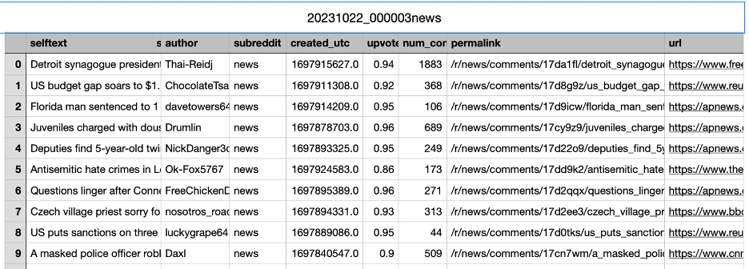
2.1 Data Management Plan (continued)
The storage format used to store the data is CSV, a sample of the data collected from subreddit news on 10/22/2023 at 00:00:03 and the screenshot of the data is provided below with the explanation for all the variables collected.
Figure: Showing all the variables

Slide 18
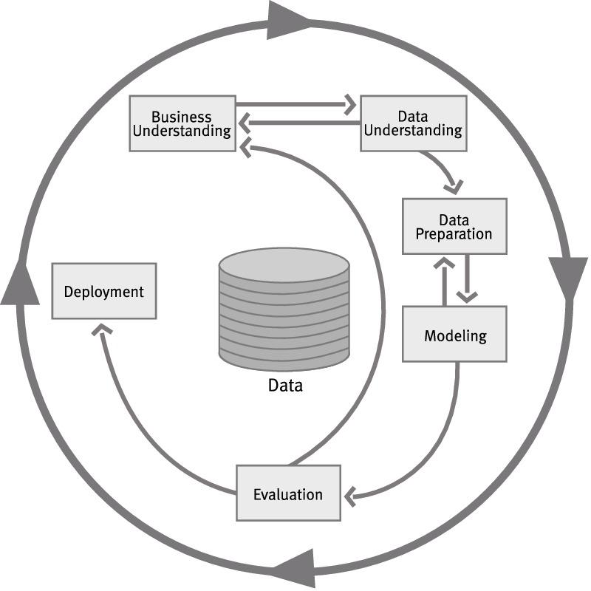
2.2 Project Development Methodology
CRISP-DM methodology is used for data mining projects, comprising six key phases
Business Understanding involves translating business goals into data mining problems
Data Understanding focuses on exploring and evaluating data quality and characteristics
Data Preparation ensures data is clean and suitable for modelling
Modelling includes selecting and building data mining models
Evaluation assesses model performance
Deployment integrates it into the business environment
Figure: CRISP-DM methods
Notes:
The process begins with collecting the data in tab-separated format (tsv) and then converting into a comma-separated format (csv) format followed by preprocessing and removing the noise from the dataset using NLP/NLTK libraries like stemming, lemmatization, and tokenization. Feature extraction has been performed by choosing lexical fetuses like word count, length. The unigram and bigram features are extracted using Tiff Vectorizer function, eventually cogenerates TF-IDF n-gram features, And some cleaning techniques such as filtering, merging, sorting, and related operations were performed. Natural language processing is also used to identify the sentiment of a post and BERT/spacy is used to embed features. The regular expressions such as paragraph break 'br' or indentation in the raw data text are replaced with a blank space. Furthermore, emoji, symbols, meaningless text, and special characters inside the text are eliminated. Other irrelevant labels, such as id, author, text content, and so on, as well as duplicated data, are eliminated. All datasets - training, testing, and competing - were standardized into a predefined structure with two categories: Query and Label ('FAKE' and 'REAL'). The cleaning task was critical because the datasets could contain meaningless variables or other components that would lead the model to be biased if they were included in the training and testing phases. Unclean data may eventually affect the results of training and testing as well.
Modeling
Model will be trained on different classification algorithms like XGboost, Random Forests, Naïve Bayes, KNN, Decision Tree, SVM, Logistic Regression, ANN, CNN, and LSTM.
• Logistic Regression – It is a binary or multiclass classification algorithm. It considers the
dataset independent of variables and predicts the dependent variable using probability.
• Decision tree – It is a non-parametric supervised learning algorithm used for
classification and regression tasks. It has a hierarchical or tree-like structure that consists
of if-else conditions based on variables.
• Random Forests – This is a commonly used machine learning algorithm that combines
the output of multiple decision trees to produce an efficient predictive model. It is a
supervised algorithm applied to both classification and regression problems.
• KNN – K-Nearest Neighbors also called instance-based learning or lazy learning, It
classifies using proximity of datapoints. It is a non-parametric supervised learning
Classifier.
• Naïve Bayes – It is a supervised machine learning algorithm commonly used for text
classification. Classifies based on Bayes’ theorem. It is a generative classifier model and
follows the first principle approach.
• SVM – Support Vector Machine used for classification, regression, and outlier detection.
However, it is widely used in classification tasks with the objective of classifying the data
points through an n-dimensional hyperplane.
• ANN – Artificial Neural Network is a deep learning algorithm based on the human brain.
It is used for forecasting issues and complicated patterns.
• LSTM – Long Short-Term Memory is capable of handling sequential data and has a
recurrent neural network capable of learning long-term dependencies. It is used in the
field of deep learning.
• XGBoost - A flexible, highly efficient, and portable gradient boosting algorithm. It
addresses a variety of data science issues quickly and accurately using the parallel tree
boosting method. Furthermore, it runs very well with large datasets because it creates
sequential decision trees through loss function optimization.
Evaluation
At this point, the models that have been implemented will be evaluated. This is done to assess the quality and efficacy of the proposed method as well as the final results. A benchmark will be generated by randomly generating the labels 'FAKE' and 'REAL' for testing the testing data. To find the accuracy of the model we have several assessment metrics can be used to evaluate the effectiveness of the model, including the confusion matrix, accuracy, F1-score, AUC-ROC (Area under Receiver Operating Characteristic curve), RMSE (Root Mean Square Error), and R2 (R- squared). Based on the comparison of these evaluation metrics, the best model for determining whether Reddit postings are fake will be selected.

Slide 19
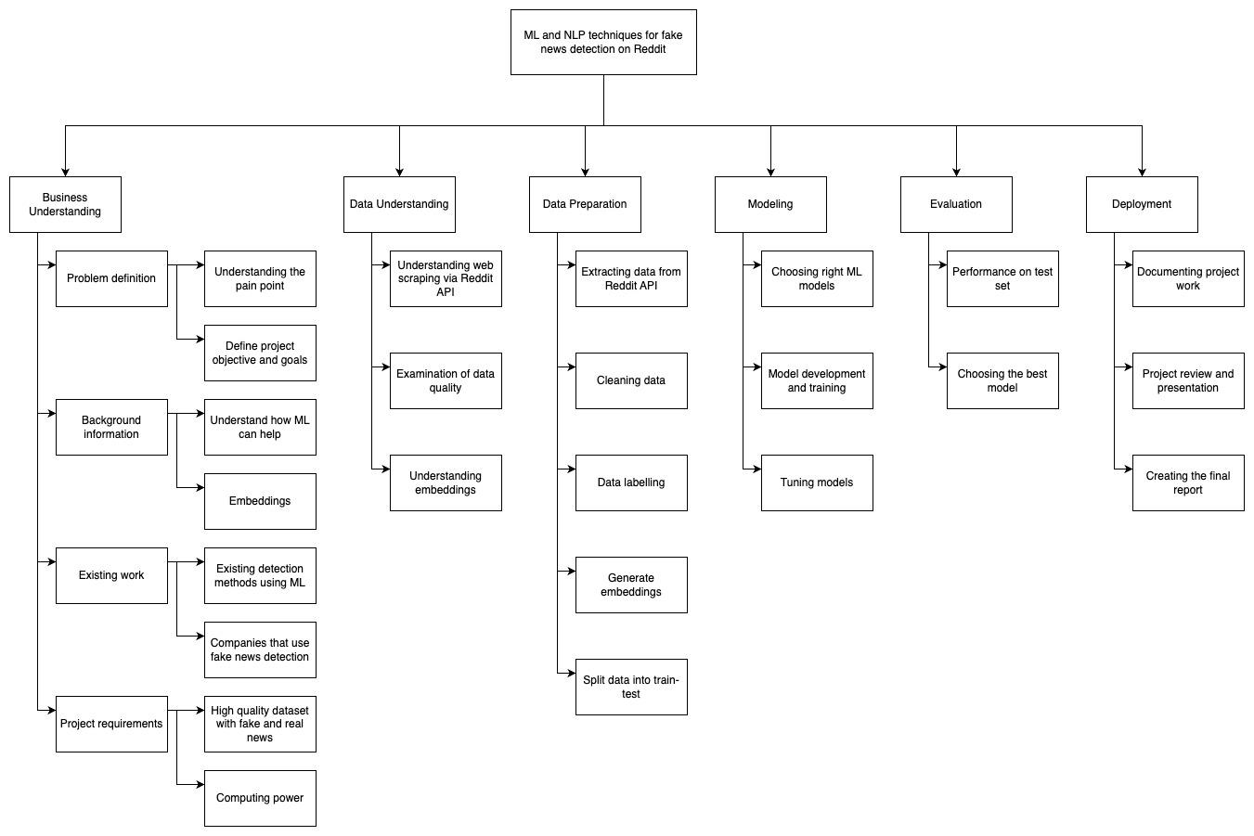
2.3 Project Organization Plan
Figure: Work breakdown structure
Notes:
We begin by defining different phases of our project. To decide these different phases, we utilise the CRISP-DM, which is a common methodology for analytical models. Figure 1 represents the WBS for our project and it also shows the 6 CRISP-DM phases in depth.
In the first phase, we start by defining our problem statement and understanding the background of fake news detection. This is an important topic that requires a robust solution because fake news spreads like a wildfire and can have adverse effects in our society. We start by revisiting previous work and try to cover the gaps in this paper.
We collect our dataset via PRAW which is an API for Reddit. We gather equal amounts of fake data and real data. After this step we label our dataset as either fake or real. In addition, we even examine the quality of data by making sure that it is rich in context and does not contain null or special characters that cannot be handled by our model. After all, the quality of the data determines the quality of the model. We transition from understanding the data to prepare it as input for our models by removing irrelevant data points. Further, we generate the embeddings that would be passed as input to a few of the deep learning models.
We will train multiple machine learning models and a few deep learning models. These models will be compared based on the computational resources required, time taken and their prediction power. To measure their predictive power, we will use multiple metrics such as F1 score, AUC-ROC, accuracy etc. Furthermore, we will even tune our models to improve their prediction power and combine multiple base models to generate powerful ensembles.
We will even follow the best practices of machine learning by splitting our data into train-val-test, where we train our models on training data, check their performance for improvements on validation set and keep our test set as an evaluation on unseen data. The evaluation stage will be where we compare our base models and ensembles on our test set.
After comparing the models on multiple fronts, we will pick our best model as the final model. During this process we will also record and track our experiments. The results along with the experiment details will be documented and presented in the project review and presentation phase.

Slide 20
2.4 Project Resource Requirements Plan
The project is implemented using tools such as
Hardware Req: Local Machine 8GB RAM 64-Bit Version, minimum of 2 CPU cores
Data Cleaning and Preprocessing: Excel, Python Jupyter Notebook, Google Collab
Machine Learning Framework and Algorithms: Scikit Learn and Google Colab
Data Visualization: Python Jupyter Notebook, Tableau
Requirements of Reddit API Praw
certifi==2023.7.22, charset-normalizer==3.2.0, idna==3.4, numpy==1.26.0, pandas==2.1.1, praw==7.7.1, prawcore==2.3.0, python-dateutil==2.8.2, pytz==2023.3.post1, requests==2.31.0, six==1.16.0, tzdata==2023.3, update-checker==0.18.0, urllib3==2.0.5, websocket-client==1.6.3

Slide 21
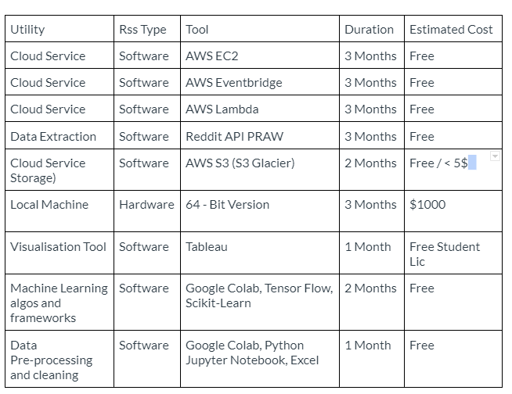
2.4 Project Resource Requirements Plan (continued)
Table: Resources and Cost Estimation

Slide 22
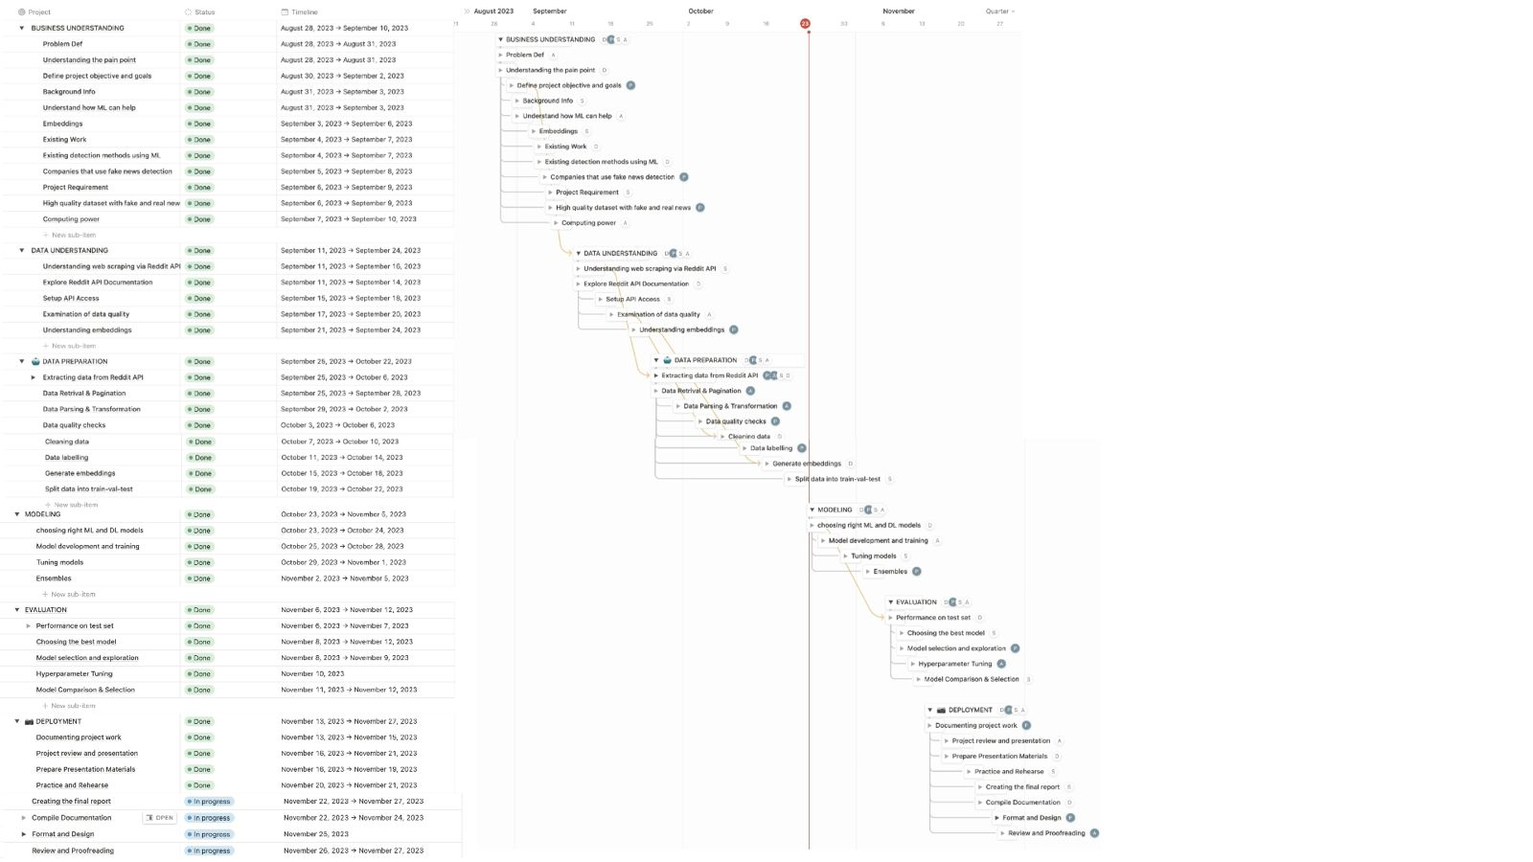
2.5 Project Schedule
Figure: GANTT Chart
Notes:
This Gantt chart displays project schedule including tasks, timeline, accountable team members, and deliverables status.

Slide 23
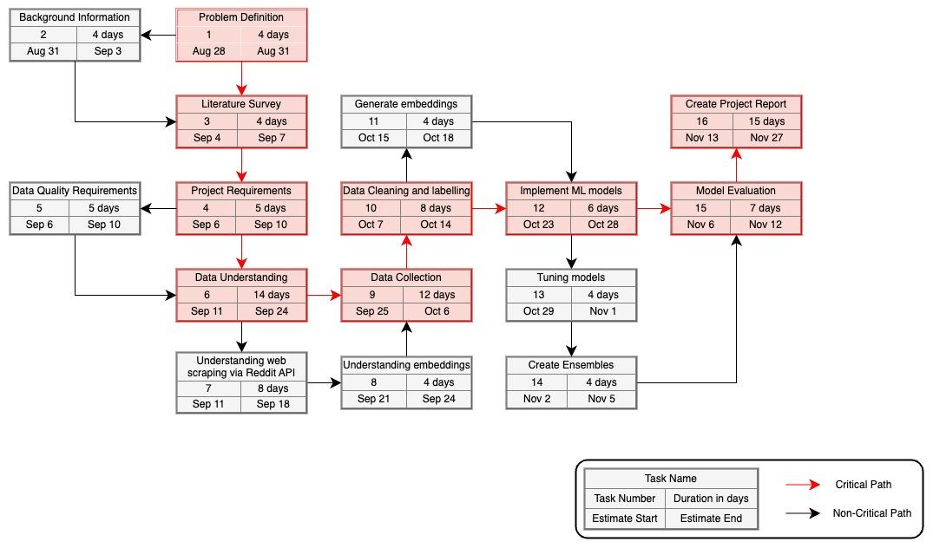
2.5 Project Schedule (continued)
Figure: PERT Chart
Notes:
The PERT chart is used to manage and schedule tasks by breaking down into individual tasks and visualising the timeline. A PERT chart assists in establishing the minimum time required to complete all the tasks by identifying the project's critical path.
Figure 2 displays the PERT chart for fake news detection on Reddit; nodes represent the project tasks and path is shown by arrows.

Slide 24
3. Data Engineering

Slide 25
3.1 Data Process
Data Collection with PRAW: The project utilizes the PRAW library to gather data from Reddit, focusing on popular posts from six specific subreddits. Information collected includes post details such as title, body text, likes, comments, URL, and post IDs.
Data Storage on AWS: The collected data is initially stored on EBS volumes before being transferred to S3 buckets. AWS EC2 instances and data collection automation via a CRON process provide a scalable and efficient solution for continuous data gathering.
Hot Post Focus: The data collection method specifically targets 'hot' posts, defined as newly created posts that have gained significant upvotes relative to their age. This ensures that the dataset reflects the most relevant and engaging content actively interacted with by Reddit users.
Train-Test Split: The collected data is divided into training, and test sets, following machine learning best practices. The training set is used for model training, and the test set for evaluating models on previously unseen data.
Scheduled Operation for Timely Updates: A CRON process enables a scheduled operation to run every six hours, ensuring the continuous collection of current and upvoted data points. This approach allows for a thorough examination of ongoing trends and patterns in post interactions on Reddit.
Notes:
The project uses PRAW library to collect data from Reddit, and we’re focusing on popular posts from six subreddits, storing collected data on AWS EBS volumes and S3 buckets. Data collection targets 'hot' posts for relevance, and the dataset is split into training, and test sets. A CRON process enables scheduled operation for continuous, up-to-date data collection.

Slide 26
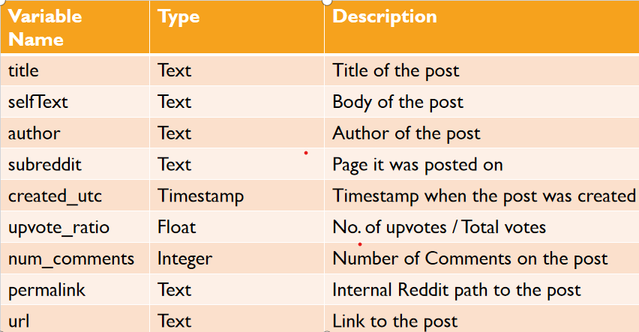
3.2 Data Collection
Wrote a python program which collects 100 ”hot” posts from a subreddit.
Iterated it through six different subreddits to collect 600 datapoints per run.
Uploaded the script to AWS EC2 instance.
Scheduled CRON job to run the python script once every 6 hours.
Tools used: Python, Reddit API & PRAW, AWS EC2 & CRON
To use the reddit API smoothly we need client_id and client_secret, this can be done by registering as Developer on the Reddit Dev website.
Add the client_id and secret as environment variable in your system.
In the code below we are accessing the client_id and client_secret using the os library and the method getenv.
This was we are successfully authenticated to use the reddit API and our client_id and client_secret remains secured.
Notes:
‘hot’ post will show new posts and how is that defined is they highly interacted with since the time of its creation. So it is related to upvotes + time.
Running the API method call once will give 100 hot posts, so we will iterate through six subreddits at once so we get 600 posts
implemented this on EC2 instance to continuously working.
We scheduled a python run CRON job once every 6 hours to collect the new, upvoted data every 6 hours.
Tools used are: python, reddit API and PRAW, AWSEC2 instance and cron job.
Reddit Authenticates before giving proper responses to your API calls.
Authentication means you need to register as a developer on the reddit dev page.
Once registered you need to create a project on the same website, once created you will be given with client_id and client_secret.
These credentials will authorize your code to officially scrape data through their API methods.
Once set, we can store the credentials as env variables to keep them secure
We can use the os.getenv to fetch the data and use in the code to authorize the code

Slide 27
3.3 Data Pre-processing
Image Text Extraction: To utilize image data in the dataset, a script downloads images using the URL column. Pytesseract extracts text from images, adding it to the dataset under the column 'image_text'. This, along with post titles and selftext, forms the basis for further processing.
Text Preprocessing Steps: The raw text from posts and images undergoes extensive preprocessing. New line characters and special characters are removed, and the text is converted to lowercase for consistency and reduced vocabulary size. URLs are removed to focus on semantic content, and tokenization using word_tokenize aids in understanding sentence structure.
Stemming and Lemmatization: Stemming (using PorterStemmer) reduces words to their root form, simplifying vocabulary. Lemmatization (using WordNetLemmatizer) ensures valid words and captures nuanced meanings for accurate classification.
Concatenation and Final Preprocessing: The 'image_text' is loaded into a new column, combined with 'selftext' and 'title', and subjected to preprocessing methods. The entire dataset is then converted to lowercase, characters are removed.
Notes:
The preprocessing involves extracting text from images using Pytesseract,
preprocessing raw text with steps including removal of special characters and URLs, conversion to lowercase, tokenization, stemming and lemmatization.
The preprocessed text is combined with 'selftext' and 'title', and converted to lowercase for final preprocessing.

Slide 28
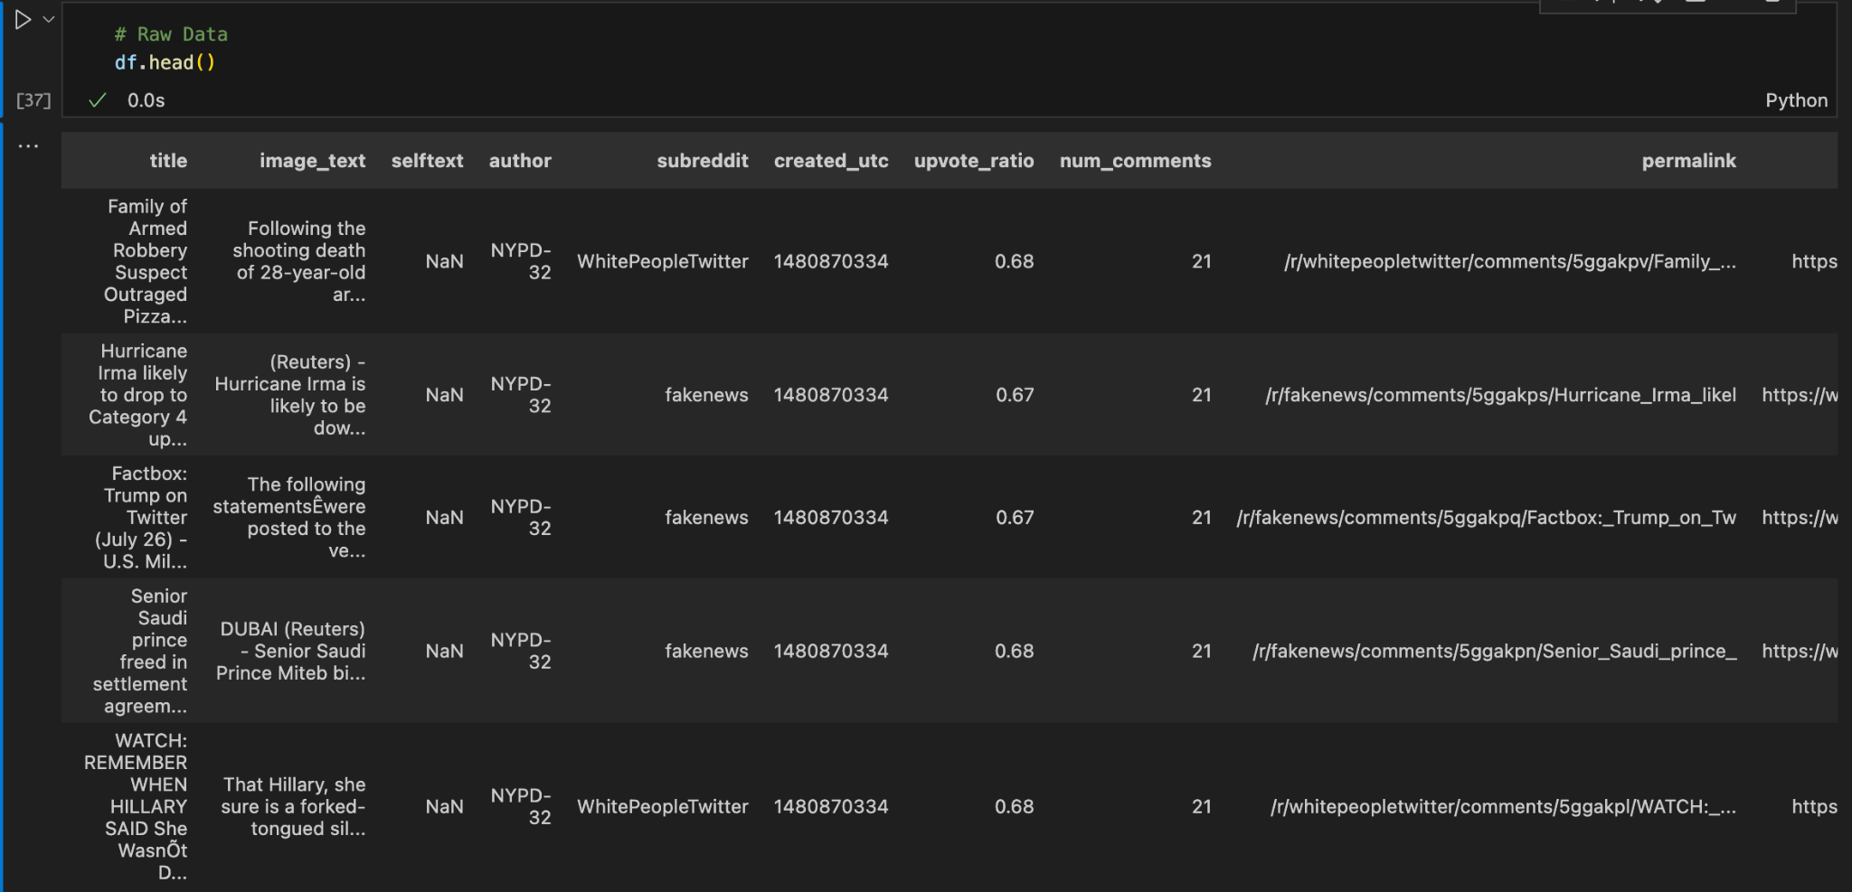
3.4 DATA PRE-PROCESSING (RAW DATA)
Notes:
overview of the raw data we pulled from the api, and we extracted the text from image.

Slide 29
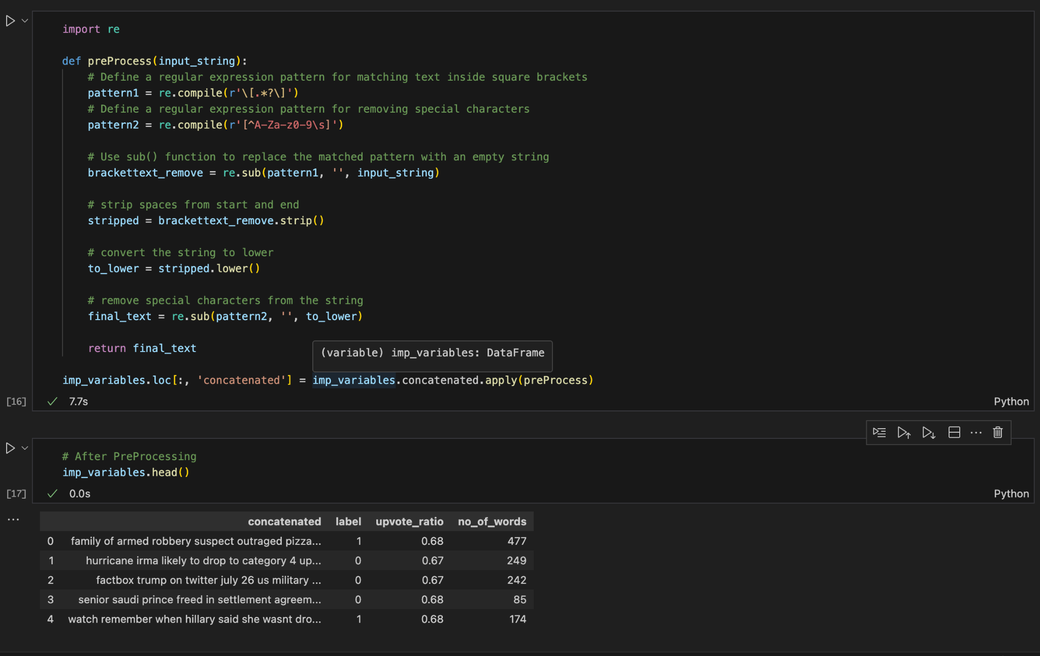
3.4 DATA PRE-PROCESSING (AFTER)
Notes:
taking out the part btw brackets
removing everything expect alpha nurmeric values
striping the words which started with spaces or ended with spaces
converting to lower case and concatinanting everything

Slide 30
3.5 Data Transformation
Text Data Transformation Techniques: Three distinct techniques - Count Vectorization, TF-IDF Vectorization, and GloVe Embedding - are employed to prepare text data for a fake news identification machine learning model.
Count Vectorization: Represents documents as word frequency vectors, creating high-dimensional sparse matrices. Each unique term serves as a feature, forming the basis for subsequent model training.
TF-IDF Vectorization: Extends Count Vectorization by considering term importance in the entire corpus. Higher weights are assigned to terms that are frequent in a document but rare in the corpus, enhancing the model's ability to discern relevance.
GloVe Embedding: Utilizes pre-trained word embeddings to transform words into dense vectors based on global statistical information. Captures semantic relationships, allowing the model to understand context and meaning, enhancing nuanced semantics in fake news detection.
Multifaceted Approach for Model Enhancement: Incorporating these vectorization methods transforms raw text data into numerical formats, providing structured input for machine learning. This multifaceted approach captures diverse aspects of the data, empowering the model to discern subtle linguistic nuances crucial for accurate classification.
Notes:
Three techniques - Count Vectorization, TF-IDF Vectorization, and GloVe Embedding - are used to transform text data for a fake news detection model. Count Vectorization represents documents as word frequency vectors, TF-IDF Vectorization assigns higher weights to rare terms, and GloVe Embedding captures semantic relationships. This multifaceted approach provides structured input for the model, enabling it to discern linguistic nuances.

Slide 31
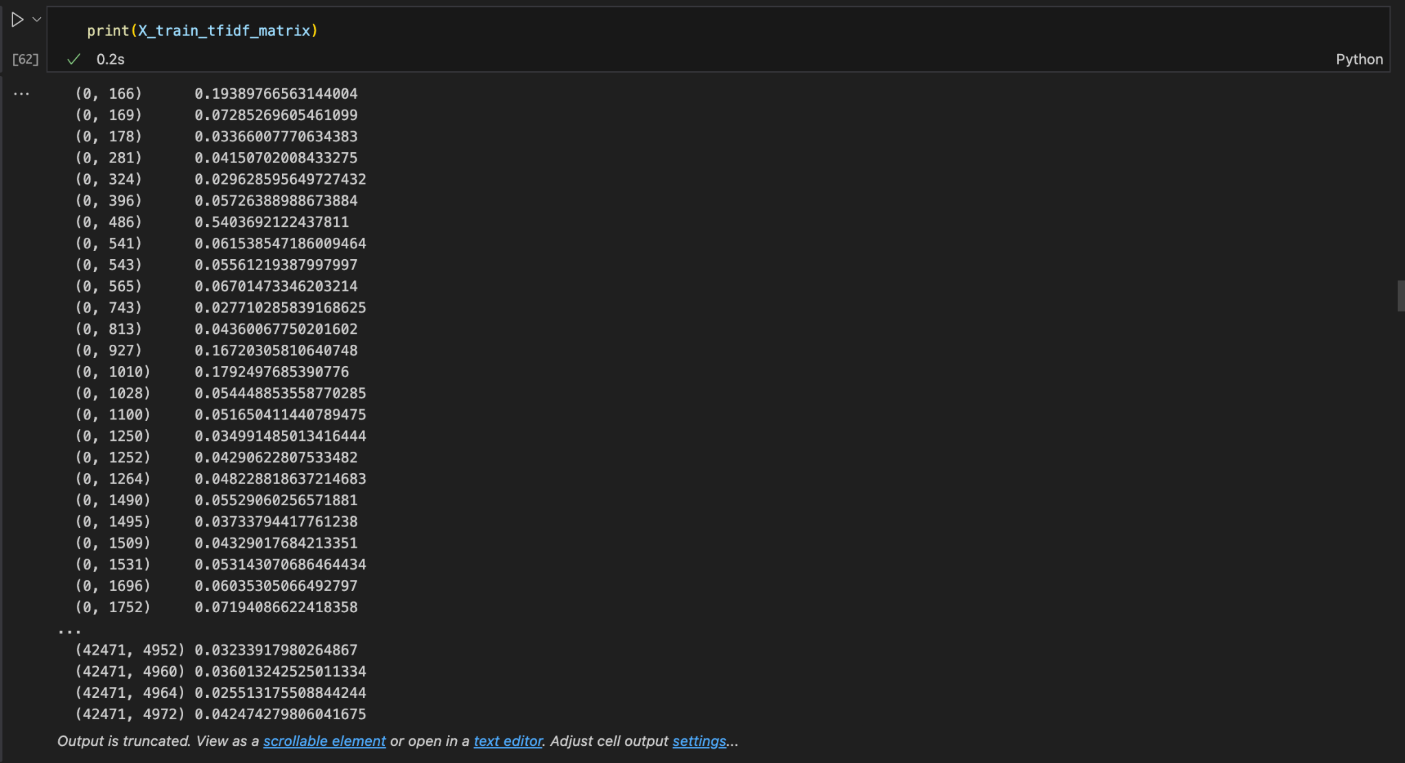
DATA TRANSFORMATION (COUNT VECTORIZATION)
Notes:
tf idf matrices
x_train works on tf idf
x_train works on coin vector

Slide 32
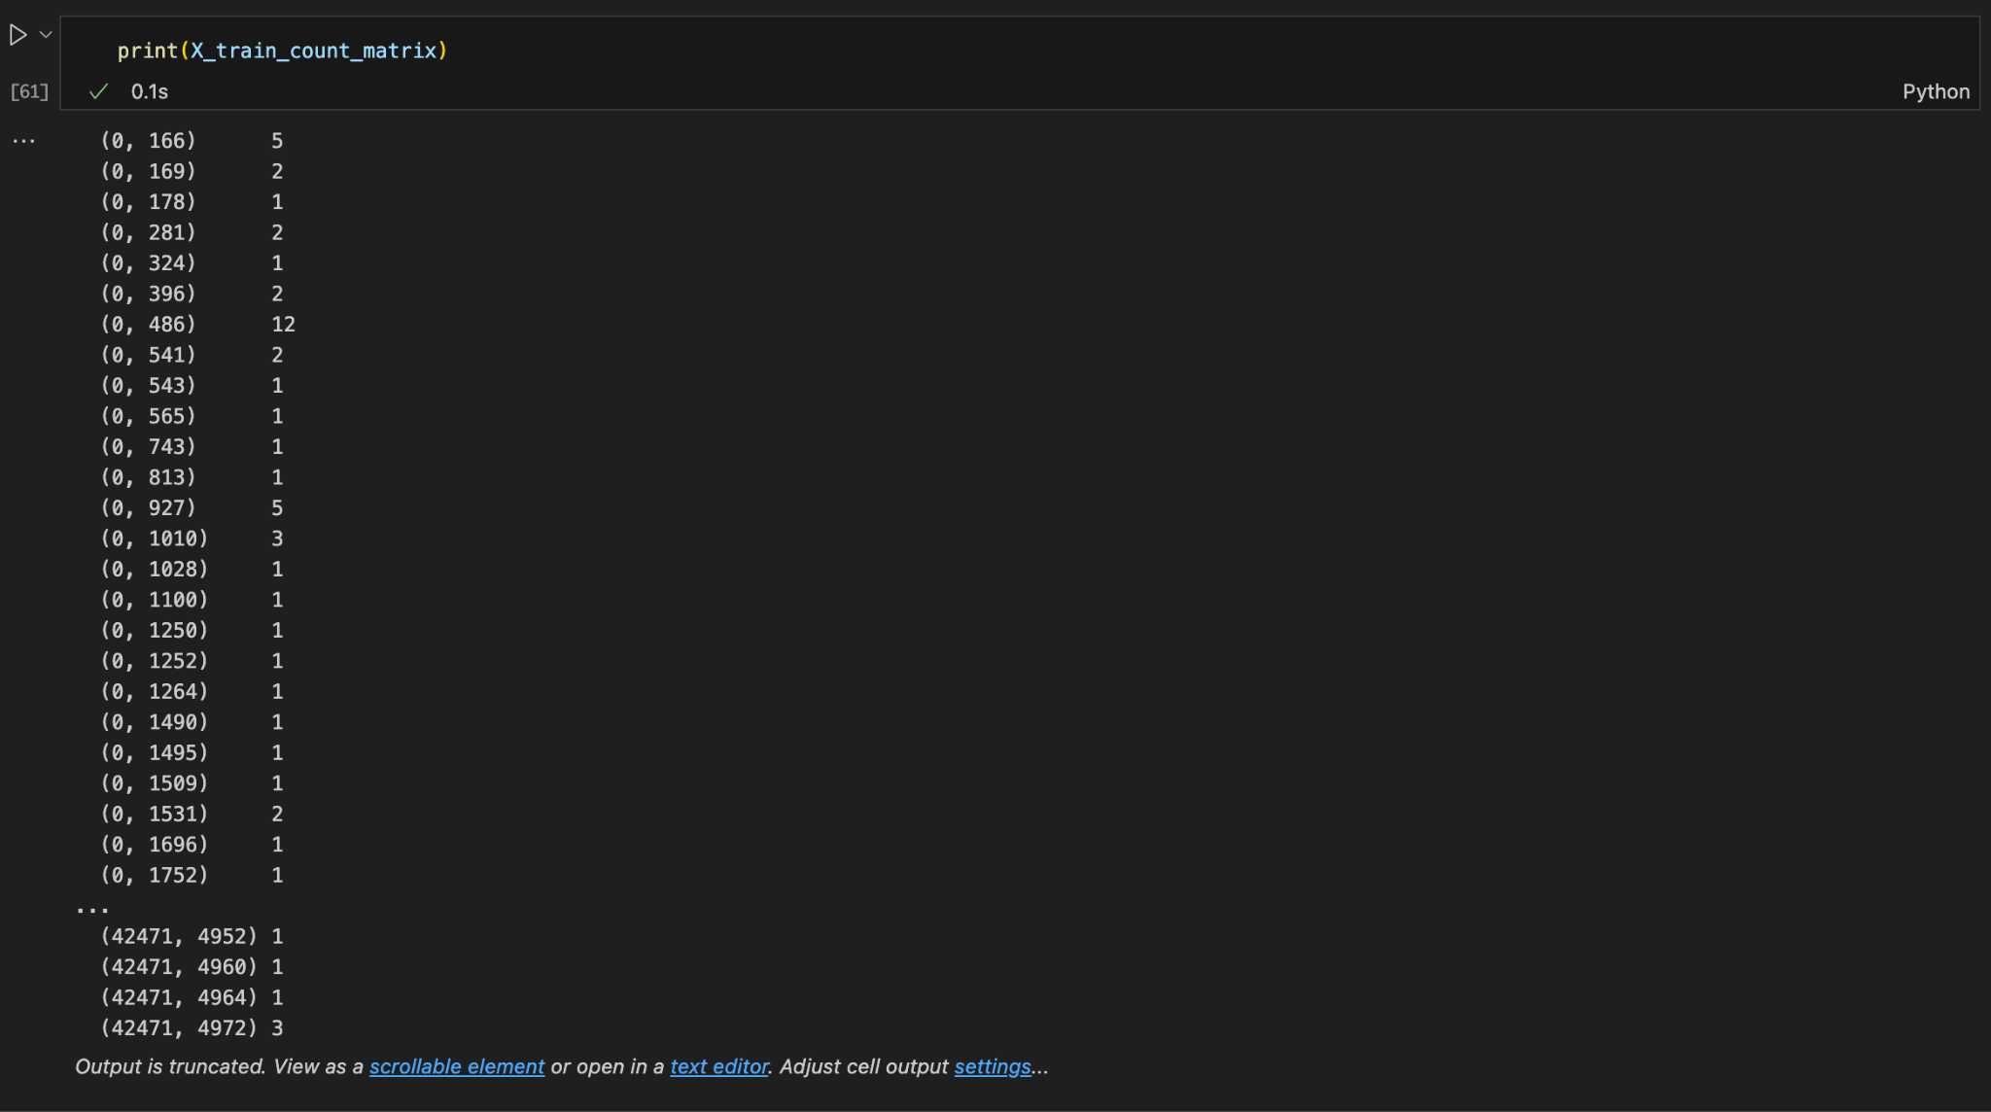
DATA TRANSFORMATION (TF-IDF)

Slide 33
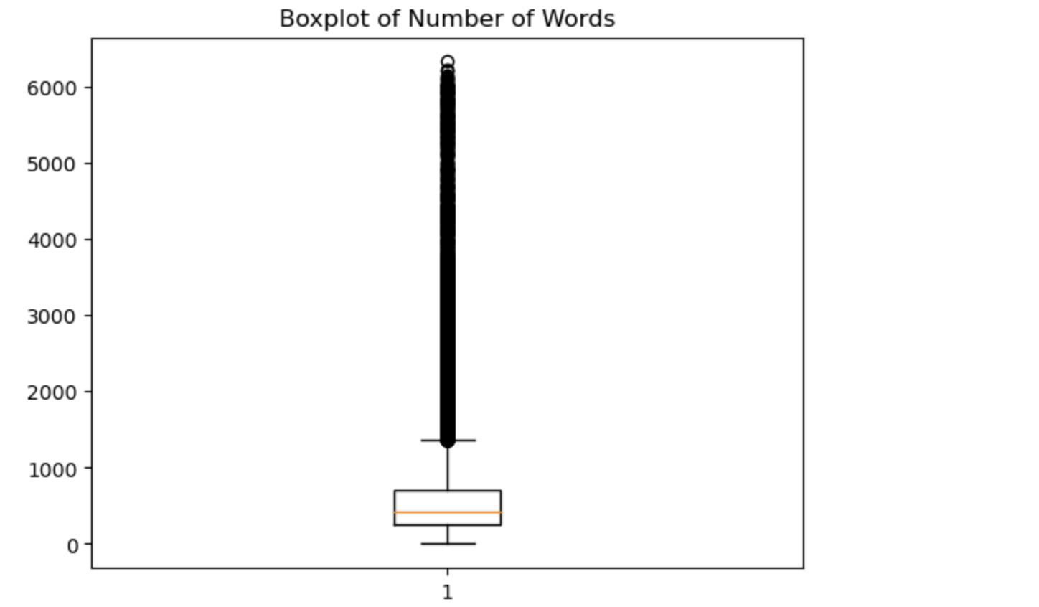
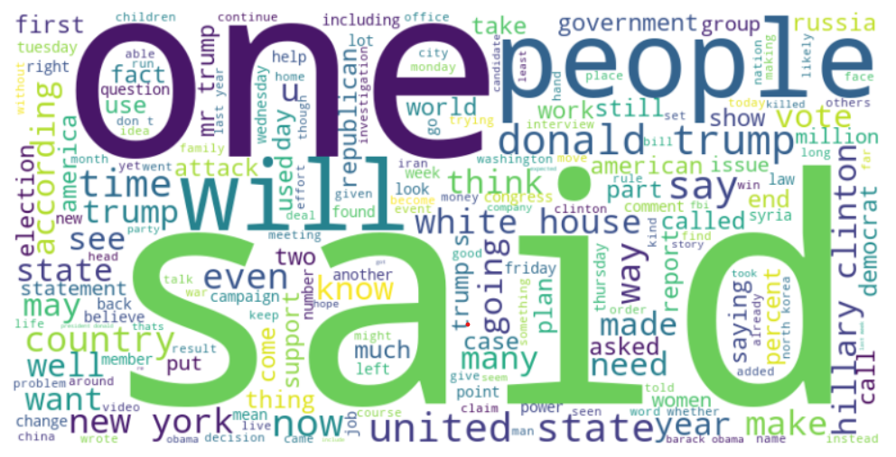
3.6 Exploratory Data Analysis

Slide 34
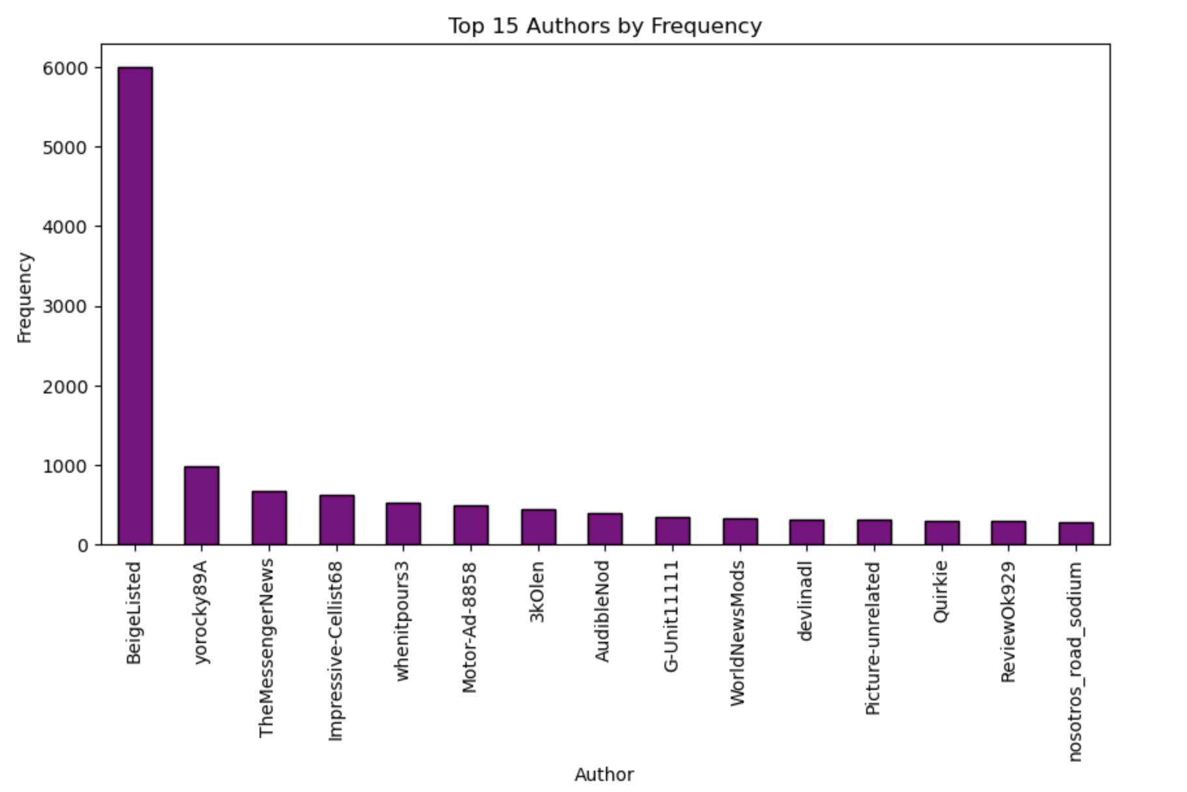
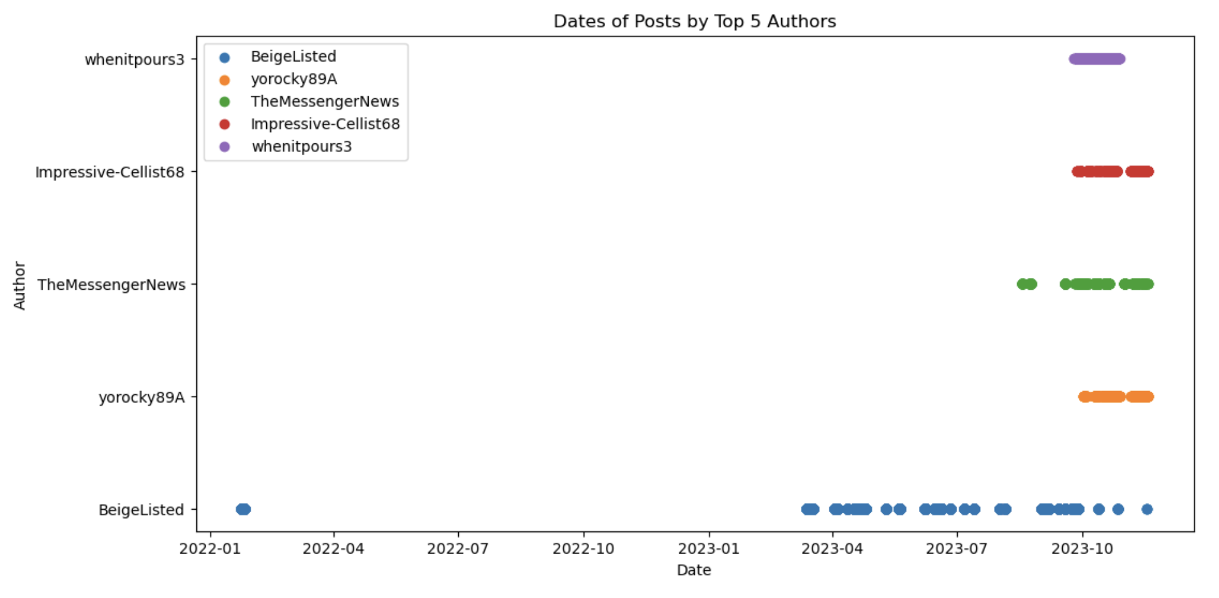
3.6 Exploratory Data Analysis (continued)
Notes:
beigelisted

Slide 35
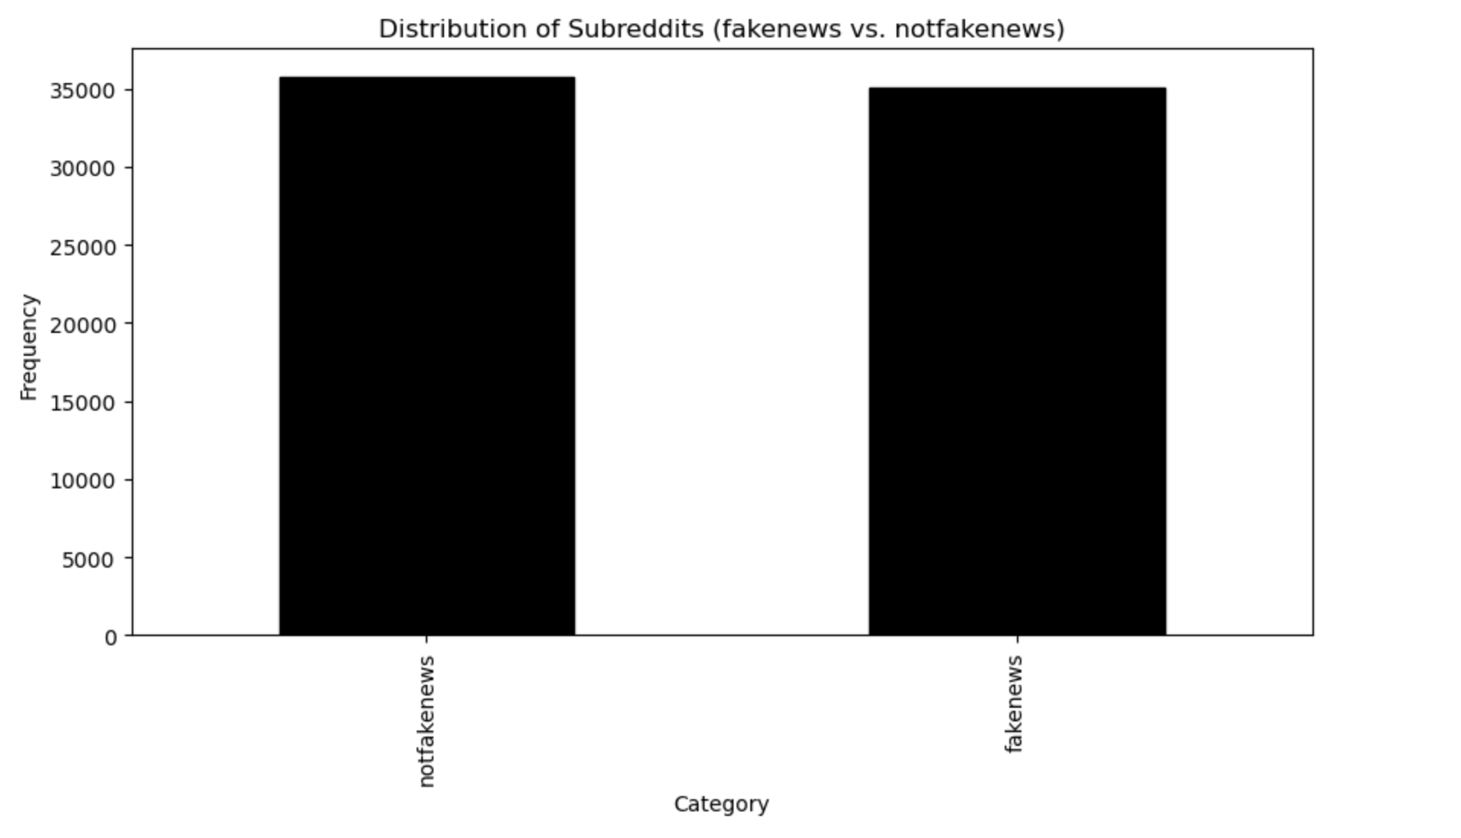
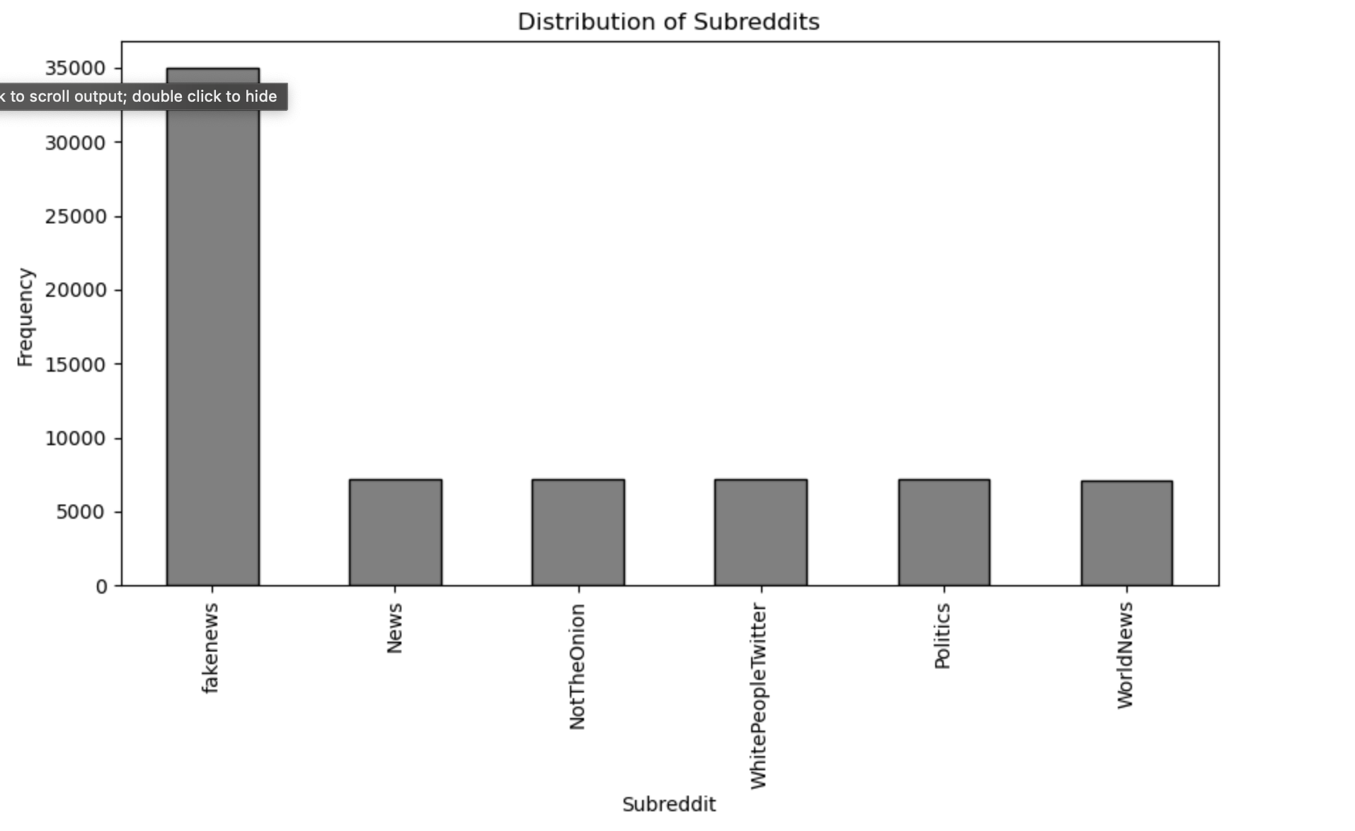
3.6 Exploratory Data Analysis (continued)
Notes:
the data here is balanced, if you go in depth and see where is this data coming from, took around 35000 fake news posts and 7000 posts from the other

Slide 36
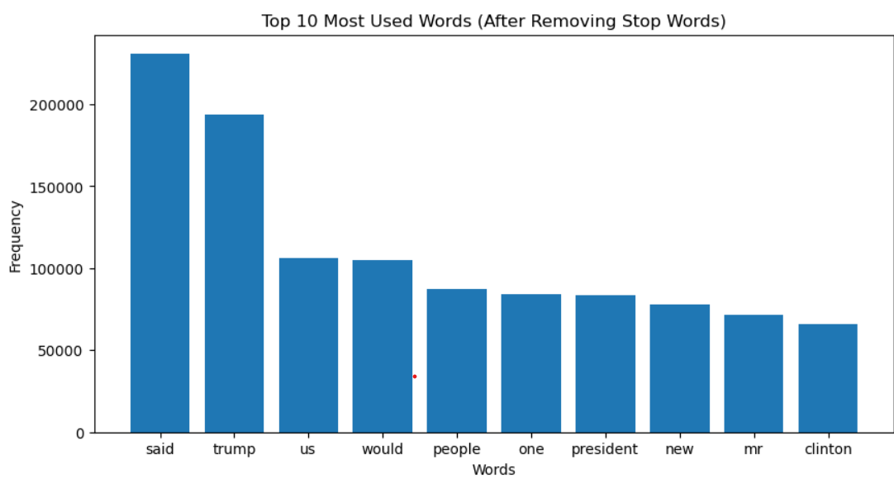
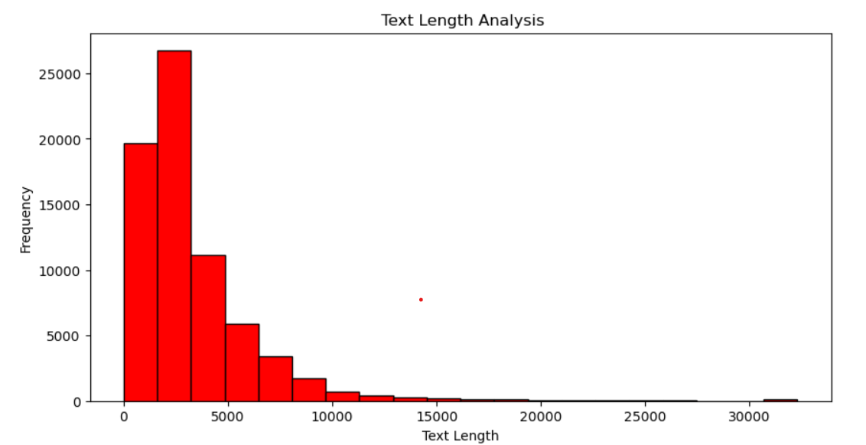
3.6 Exploratory Data Analysis (continued)
Notes:
the number of repeated words are listed here in bar graph, and the length of the post length is averaged to 2500 words

Slide 37
4. Model Development

Slide 38
4.1 Model Proposals
Logistic Regression: A linear regression-based classification model that uses a logistic function to estimate probabilities.
Support Vector Machine (SVM): A supervised learning model that maps input data to a high-dimensional space using kernel functions to separate classes.
Decision Tree: A tree-structured model that splits data based on feature values to create hierarchical decision rules.
Random Forest: An ensemble learning method that combines multiple decision trees trained on random subsets of features and data instances.
Naive Bayes: A probabilistic classifier based on Bayes' theorem, assuming feature independence.
Notes:
to solve this problem we decided to go with these five models, lr, svm, dt, rf and nb.

Slide 39
4.2 Model Supports
Tools:
Python: Python is a widely used programming language for data analytics and machine learning. It offers extensive libraries such as scikit-learn, pandas, and numpy, which are essential for model development.
Jupyter Notebook: Jupyter Notebook provides an interactive environment for writing and executing code. It allows you to document your code, visualize data, and share your work with others.
scikit-learn: scikit-learn is a powerful machine learning library in Python. It provides implementations of various models, including logistic regression, SVM, decision trees, random forests, and Naive Bayes. It also offers tools for data preprocessing, model evaluation, and cross-validation.
Notes:
We have used the following 3 tools to build the models. We used the widely used Python programming language to perform data analytics and machine learning, the extensive libraries python which include pandas, numpy, matplotlib etc makes it the best choice.
we used the jupyter interactive environment for writing and executing code
scikit-learn has many machine learning libraries which helped us implement complex algorithms with ease.

Slide 40
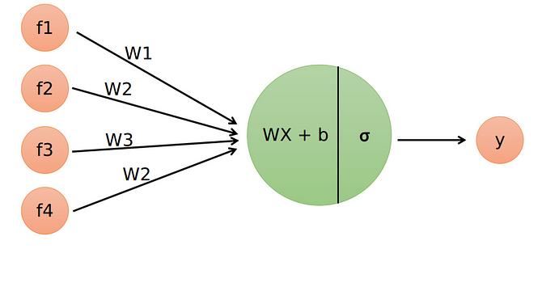
Logistic Regression
Binary Classification: Logistic regression is a statistical method used for binary classification problems, making it suitable for distinguishing between real and fake news.
Interpretability: It provides a clear interpretation of the relationship between input features and the likelihood of a news article being fake.
Efficiency: Logistic regression is computationally efficient and can handle large datasets, making it practical for processing a significant amount of news articles.

Slide 41
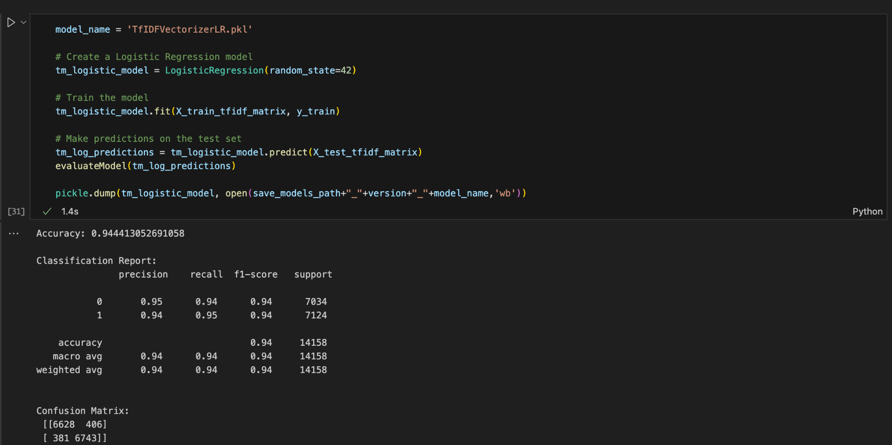
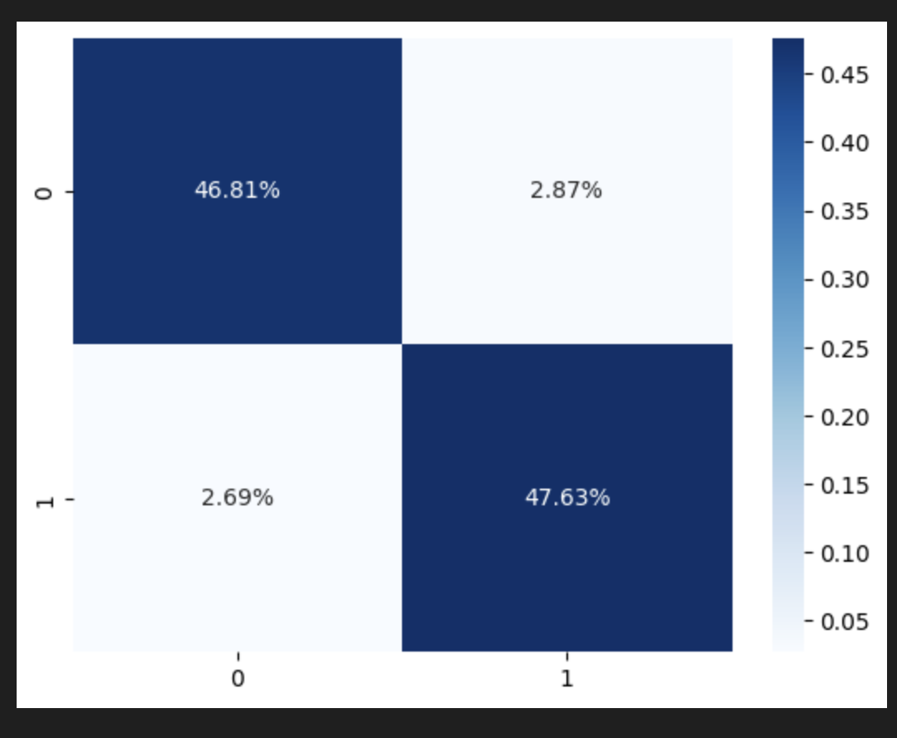
4.3 Model Comparison
4.3.2) Logistic Regression with Tf-IDF Vectorized Values

Slide 42
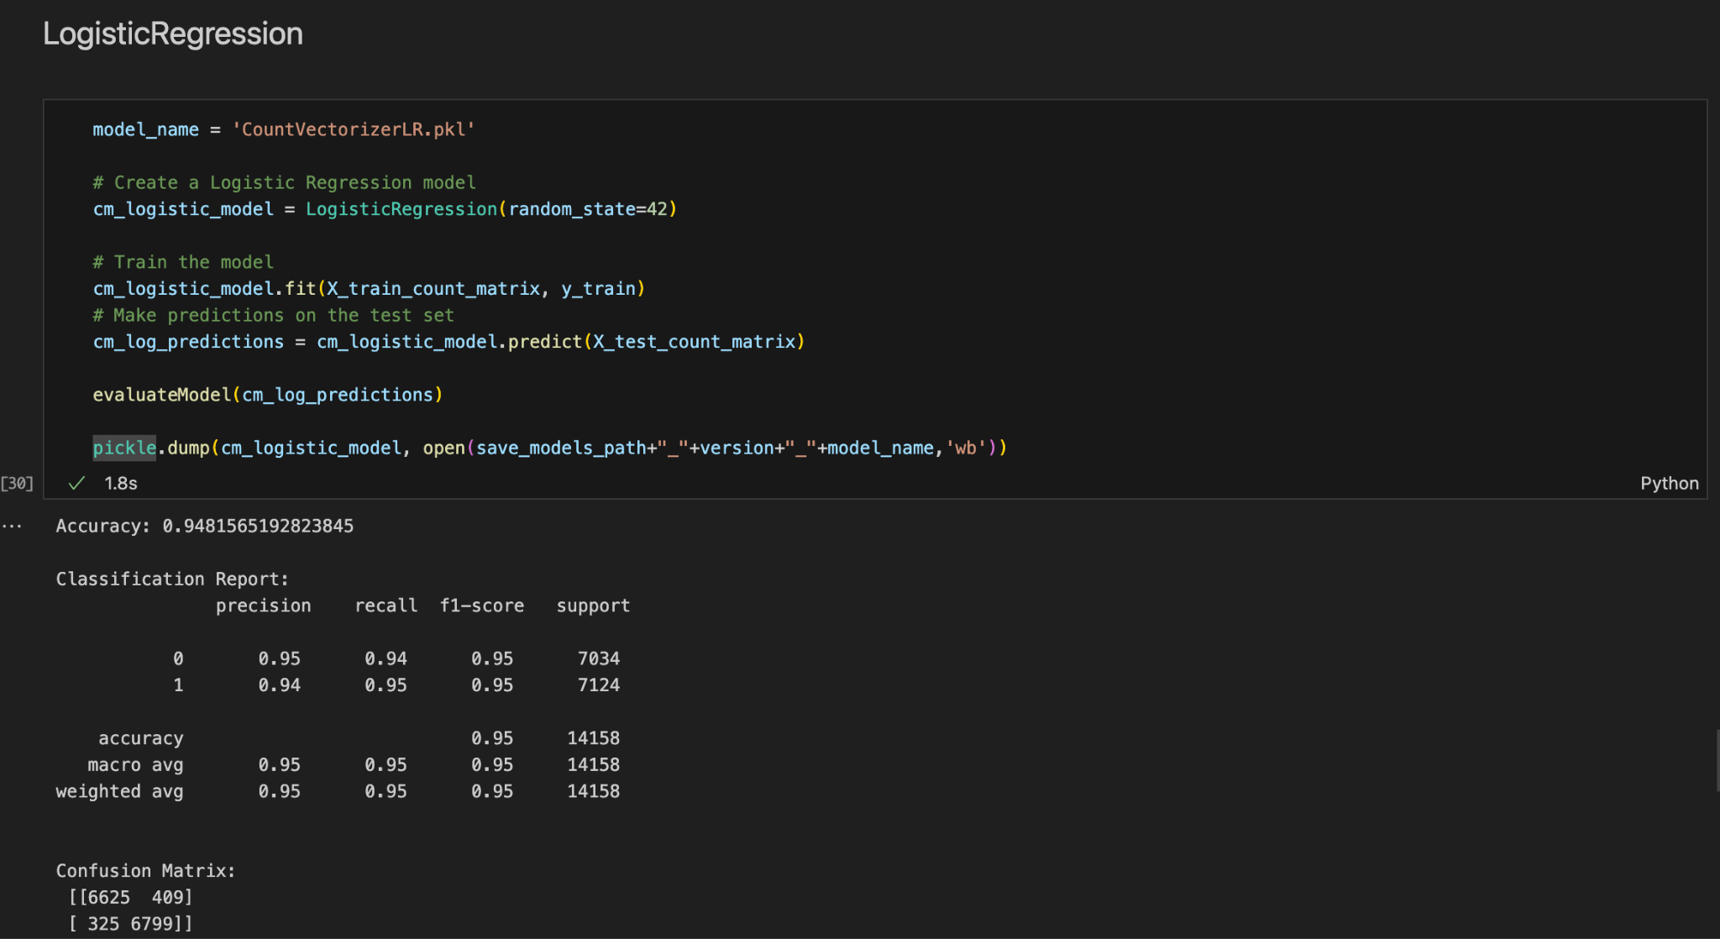
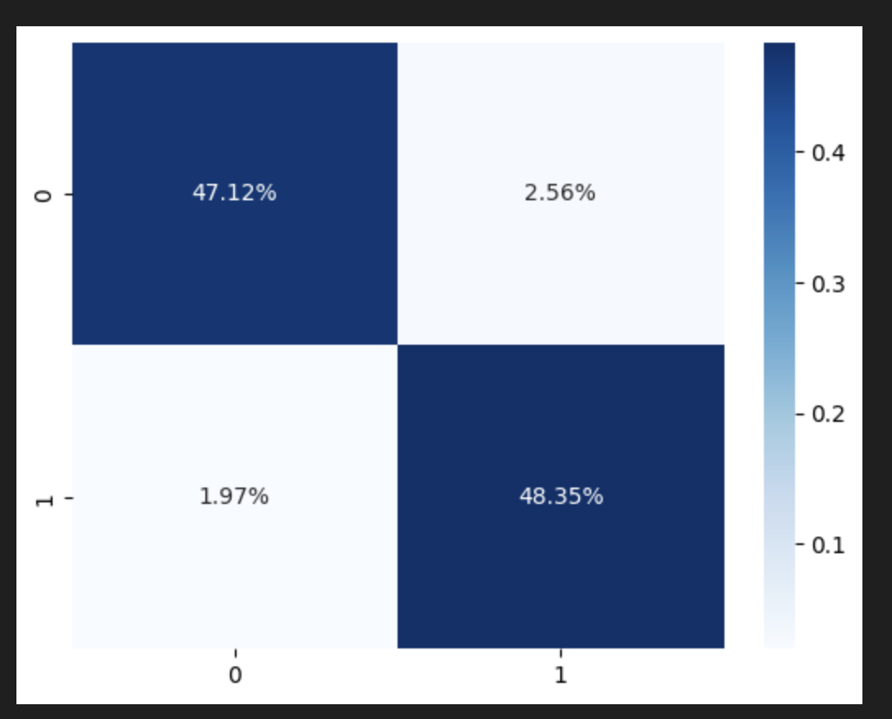
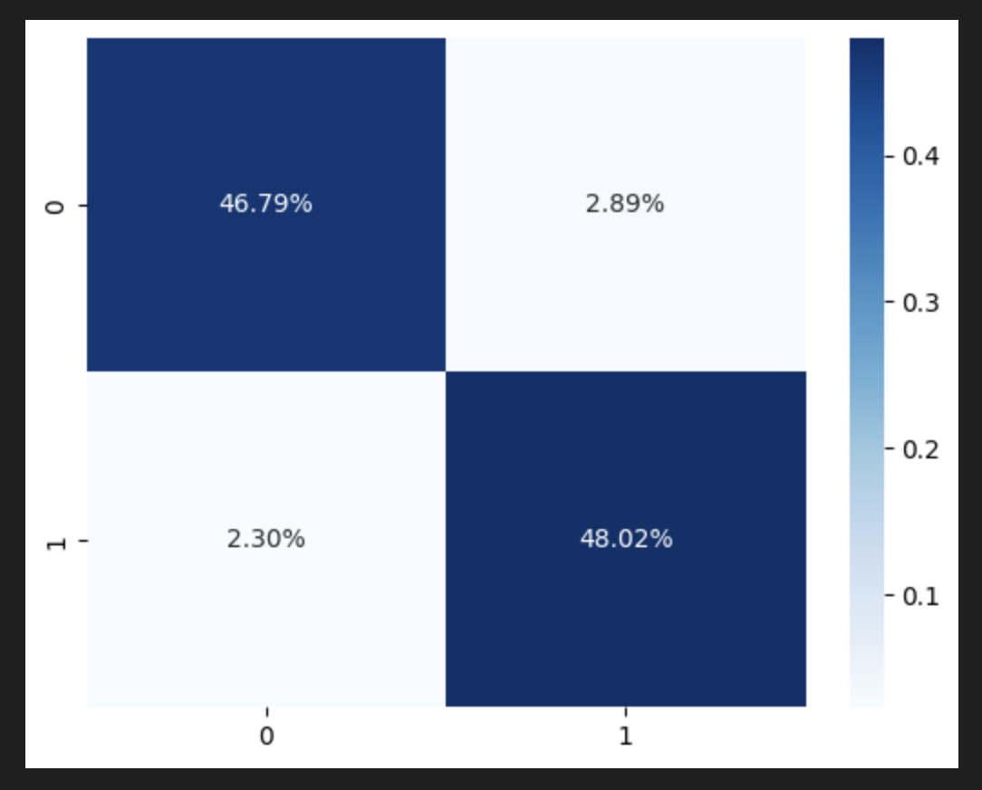
4.3 Model Comparison
4.3.1) Logistic Regression with Count Vectorized Values

Slide 43
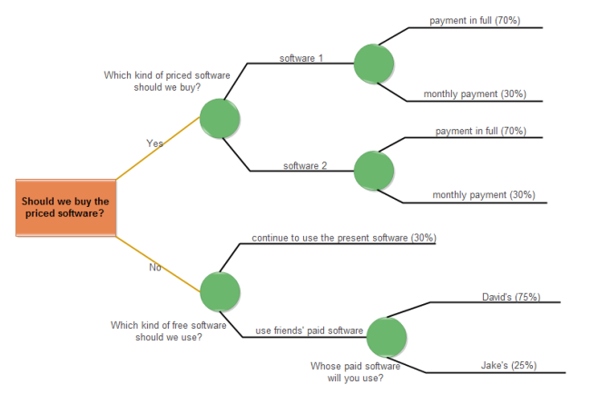
Decision Tree
Intuitive Decision Making: Decision trees are easy to understand and interpret, making it simpler to identify the key features influencing the classification of news as real or fake.
Feature Importance: Decision trees can highlight important features for classification, aiding in understanding the criteria used to make decisions.
Nonlinear Relationships: Decision trees can capture nonlinear relationships in data, allowing them to discern intricate patterns in news articles that may indicate misinformation.
Notes:
Intuitive Decision Making: Decision trees are easy to understand and interpret, making it simpler to identify the key features influencing the classification of news as real or fake.
Feature Importance: Decision trees can highlight important features for classification, aiding in understanding the criteria used to make decisions.
Nonlinear Relationships: Decision trees can capture nonlinear relationships in data, allowing them to discern intricate patterns in news articles that may indicate misinformation.

Slide 44
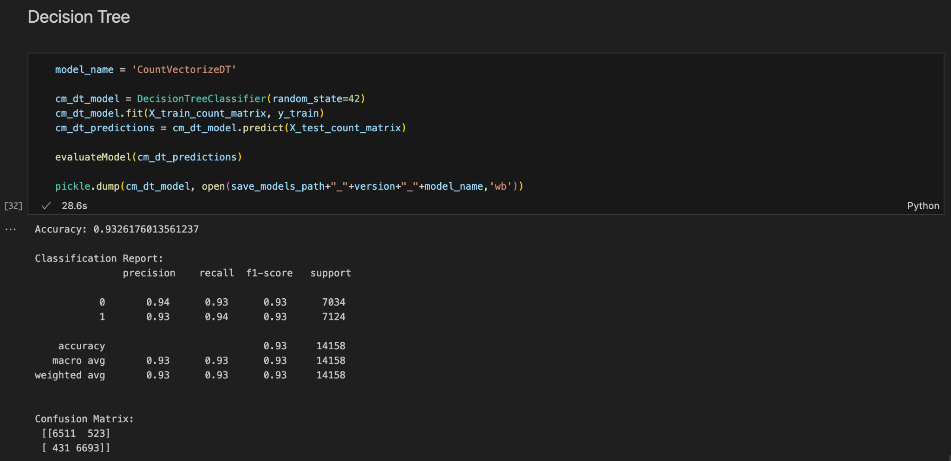
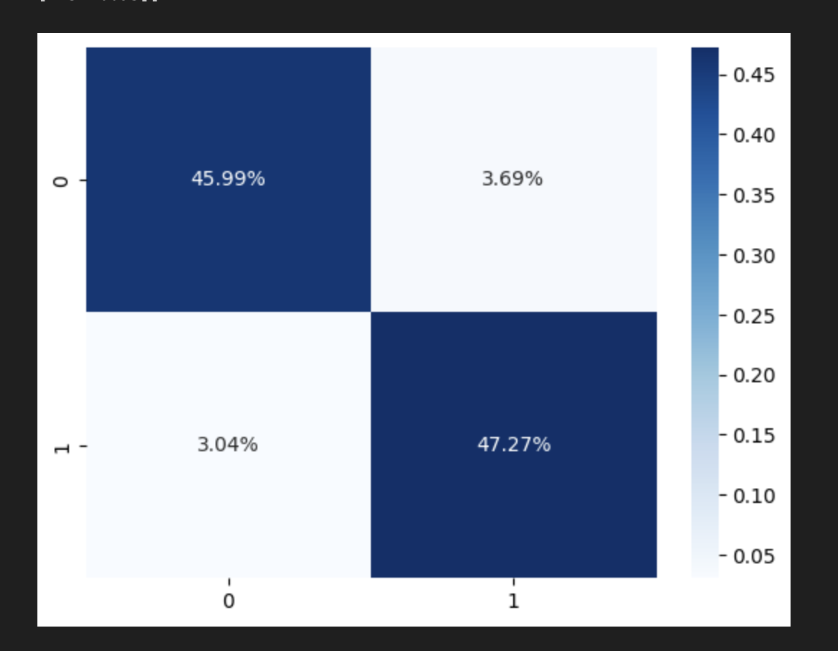
4.3 Model Comparison
4.3.3) Decision Tree with Count Vectorized Values

Slide 45
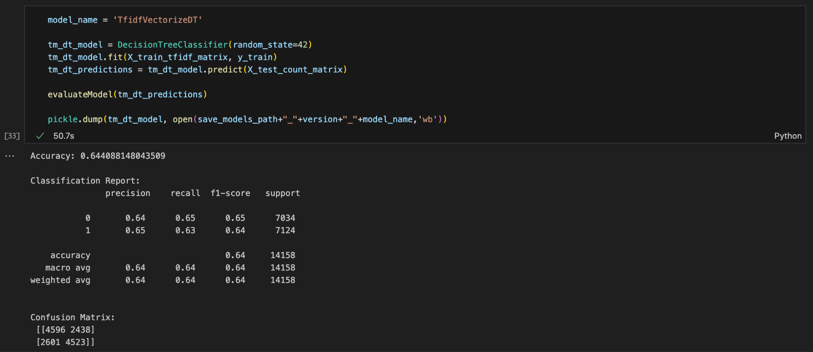
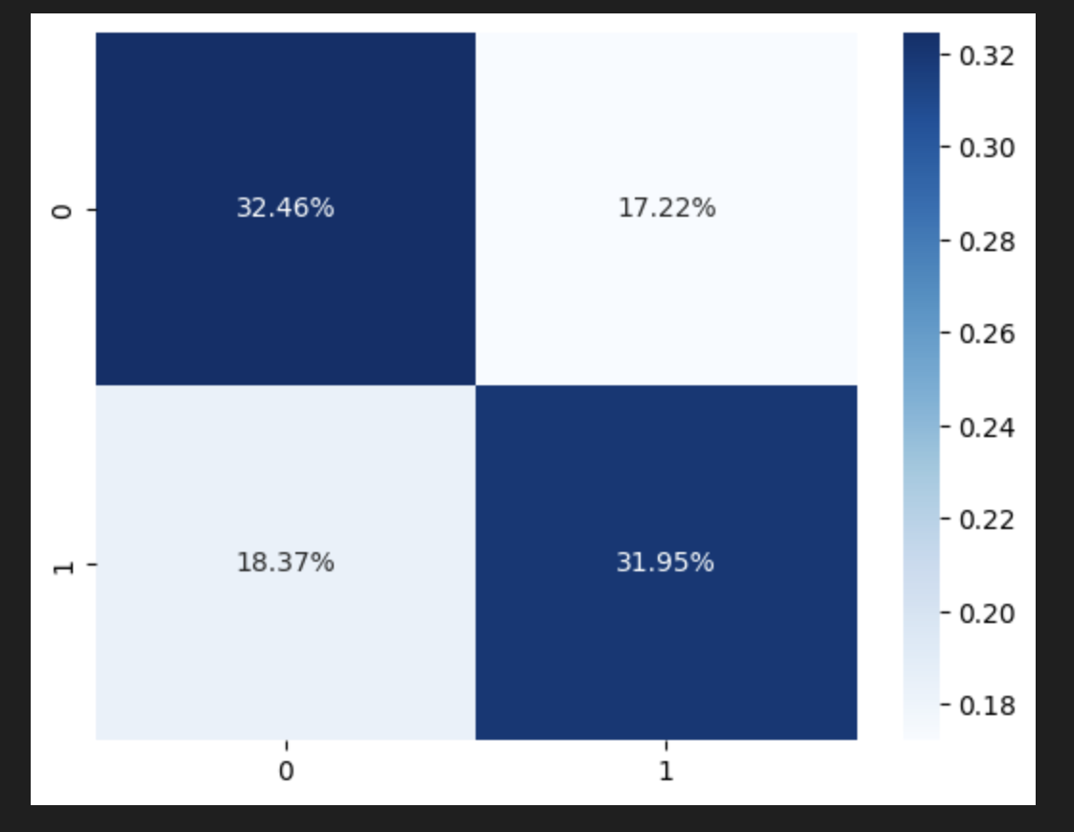
4.3 Model Comparison
4.3.4) Decision Tree with Tf-IDF Vectorized Values

Slide 46

Random Forest
Ensemble Learning: Random Forest is an ensemble of decision trees, which enhances the model's accuracy and robustness by aggregating predictions from multiple trees.
Reduced Overfitting: The ensemble nature of Random Forest helps mitigate overfitting, providing better generalization to unseen data.
Feature Importance: Random Forest can provide insights into feature importance, aiding in identifying the most relevant factors for fake news classification.
Notes:
Ensemble Learning: Random Forest is an ensemble of decision trees, which enhances the model's accuracy and robustness by aggregating predictions from multiple trees.
Reduced Overfitting: The ensemble nature of Random Forest helps mitigate overfitting, providing better generalization to unseen data.
Feature Importance: Random Forest can provide insights into feature importance, aiding in identifying the most relevant factors for fake news classification.

Slide 47
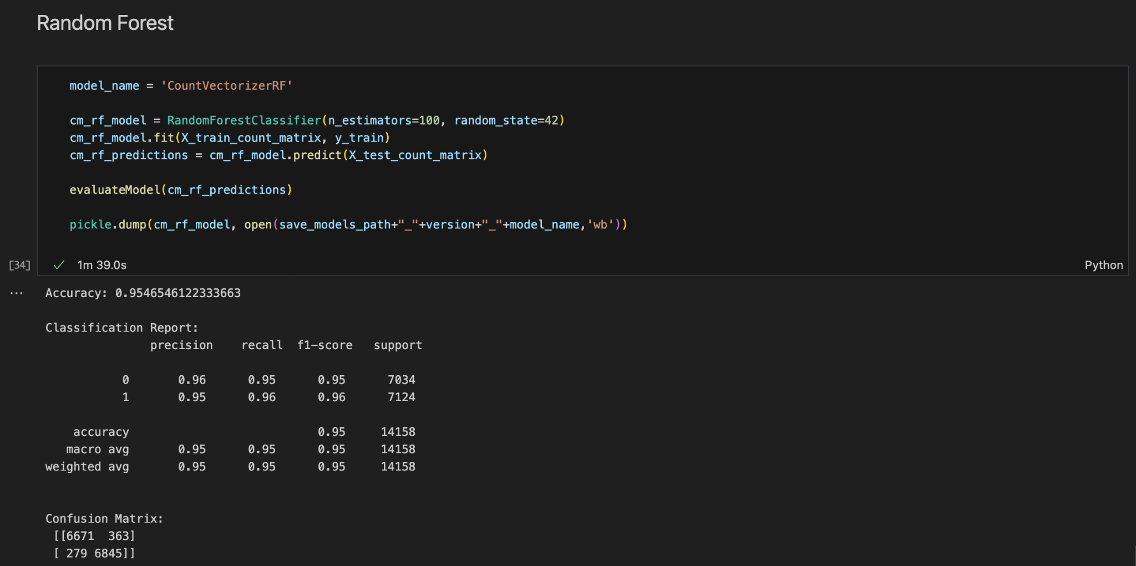
4.3 Model Comparison
4.3.5) Random Forest with Count Vectorized Values

Slide 48
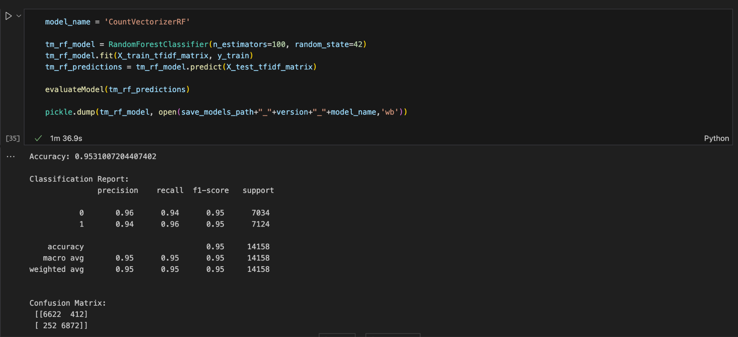
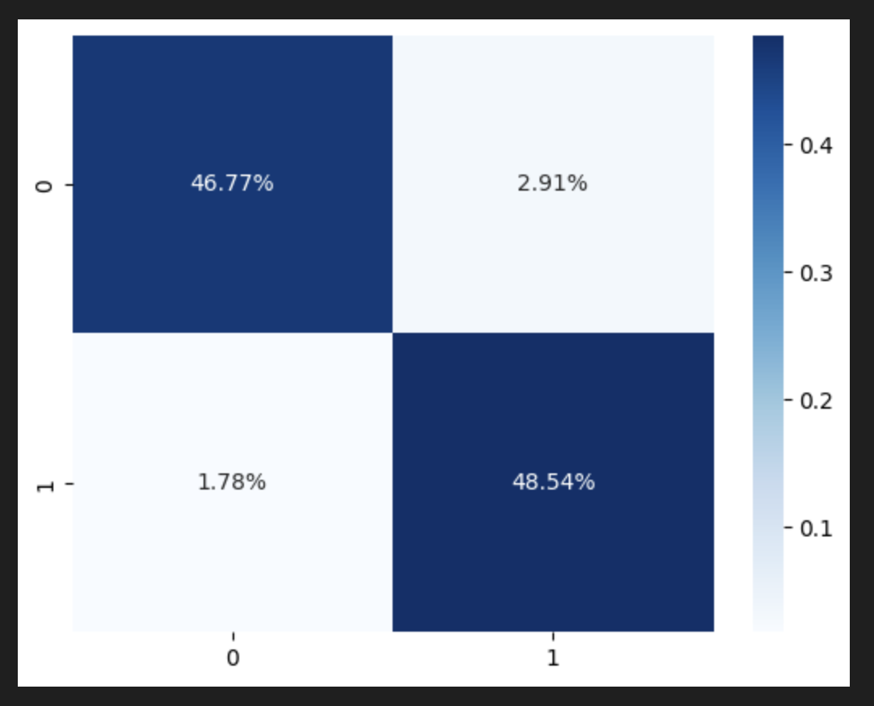
4.3 Model Comparison
4.3.6) Random Forest with Tf-IDF Vectorized Values

Slide 49
Support Vector Machine
Effective in High-Dimensional Spaces: SVM is powerful in high-dimensional spaces, making it suitable for tasks like text classification where the feature space can be vast.
Margin Maximization: SVM aims to find the hyperplane that maximizes the margin between different classes, providing a robust decision boundary.
Kernel Tricks: SVM can use kernel functions to handle non-linear relationships in data, allowing it to capture complex patterns in news articles that might indicate fake news.
Notes:
Effective in High-Dimensional Spaces: SVM is powerful in high-dimensional spaces, making it suitable for tasks like text classification where the feature space can be vast.
Margin Maximization: SVM aims to find the hyperplane that maximizes the margin between different classes, providing a robust decision boundary.
Kernel Tricks: SVM can use kernel functions to handle non-linear relationships in data, allowing it to capture complex patterns in news articles that might indicate fake news.

Slide 50
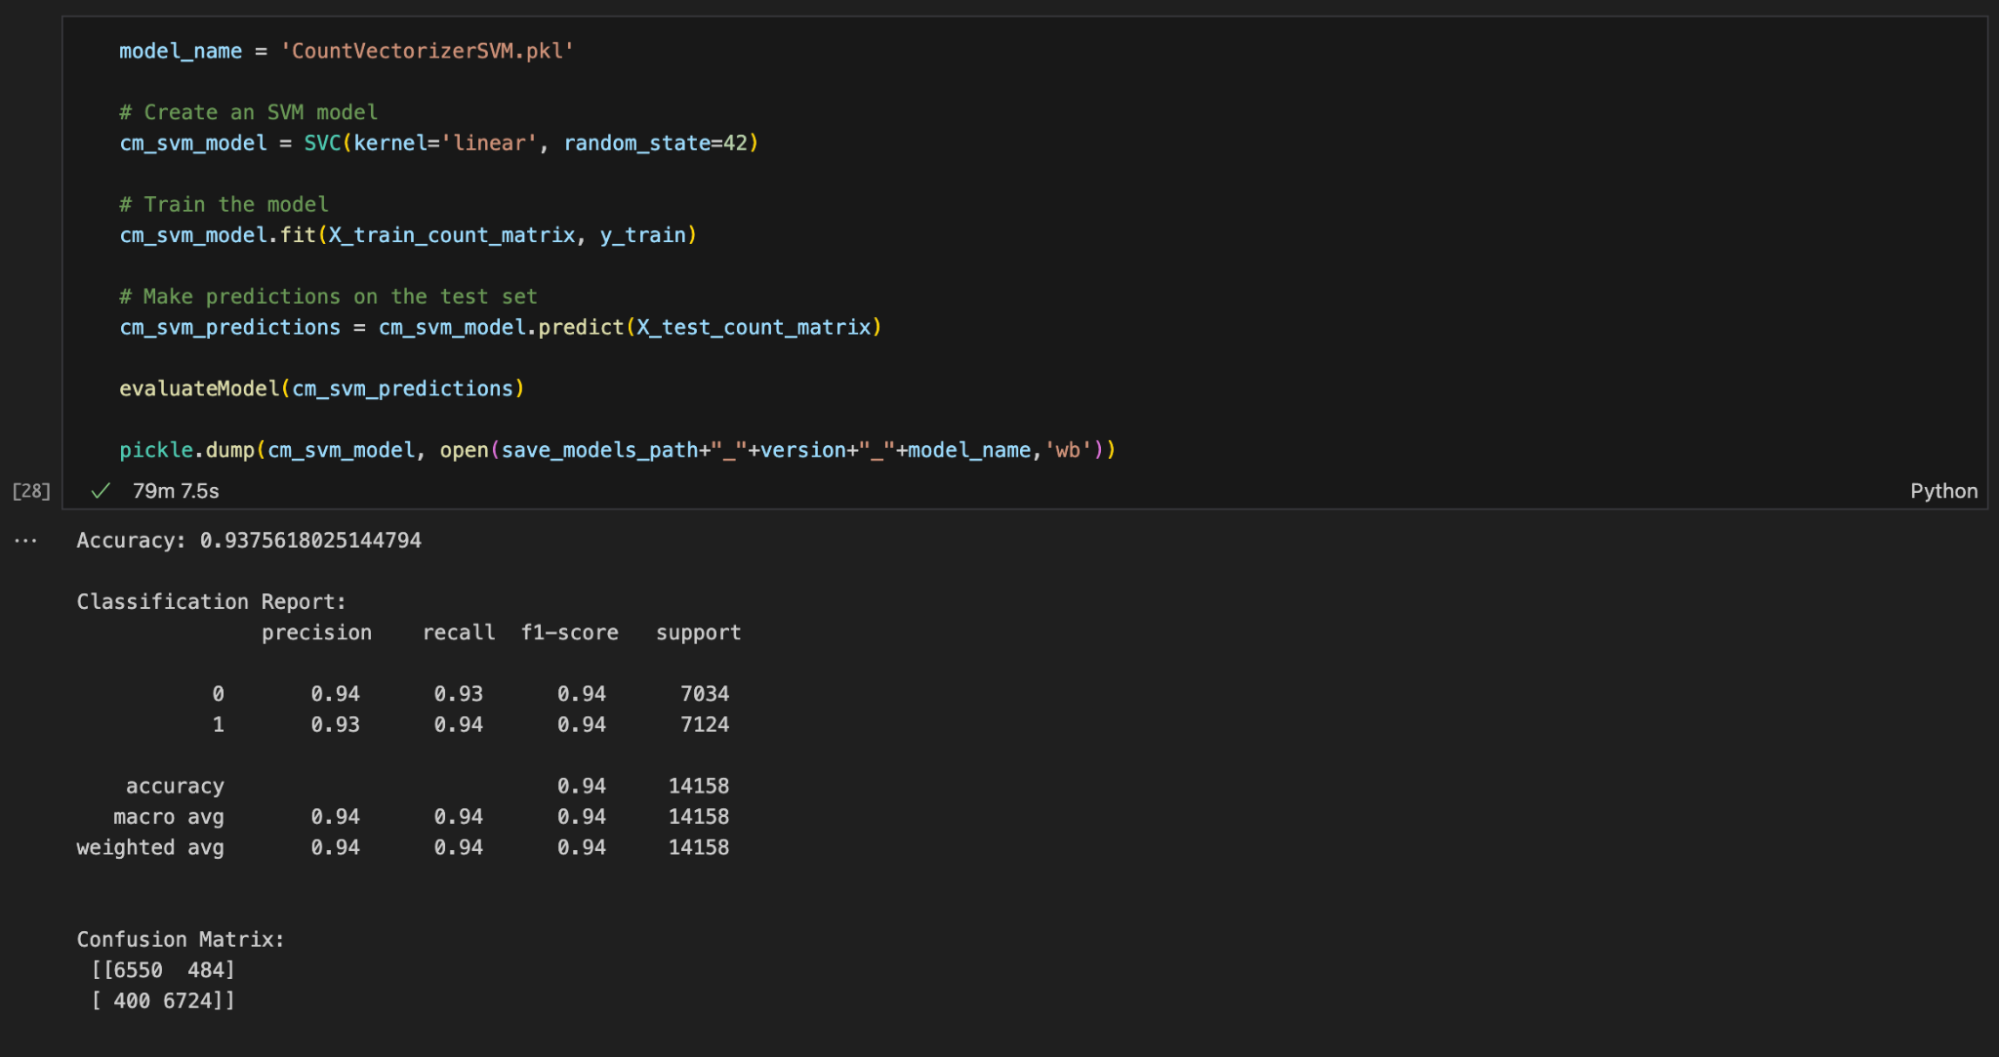
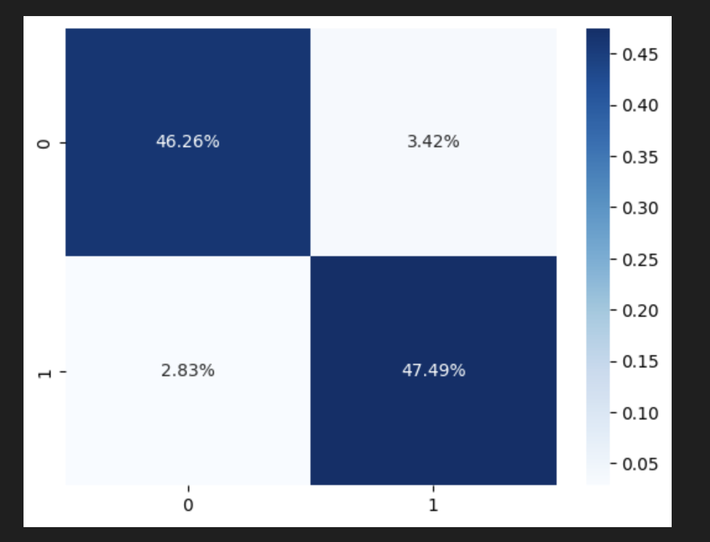
4.3 Model Comparison
4.3.7) SVM with Count-IDF Vectorized Values

Slide 51
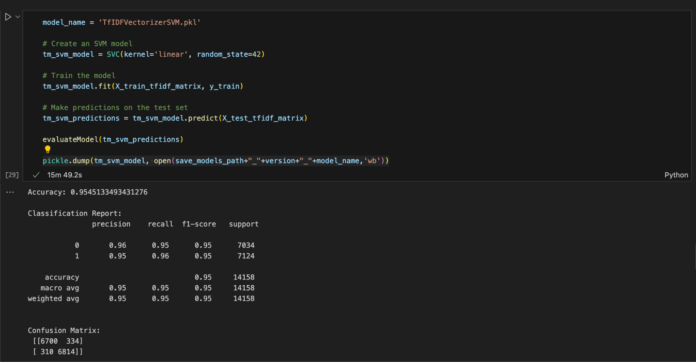
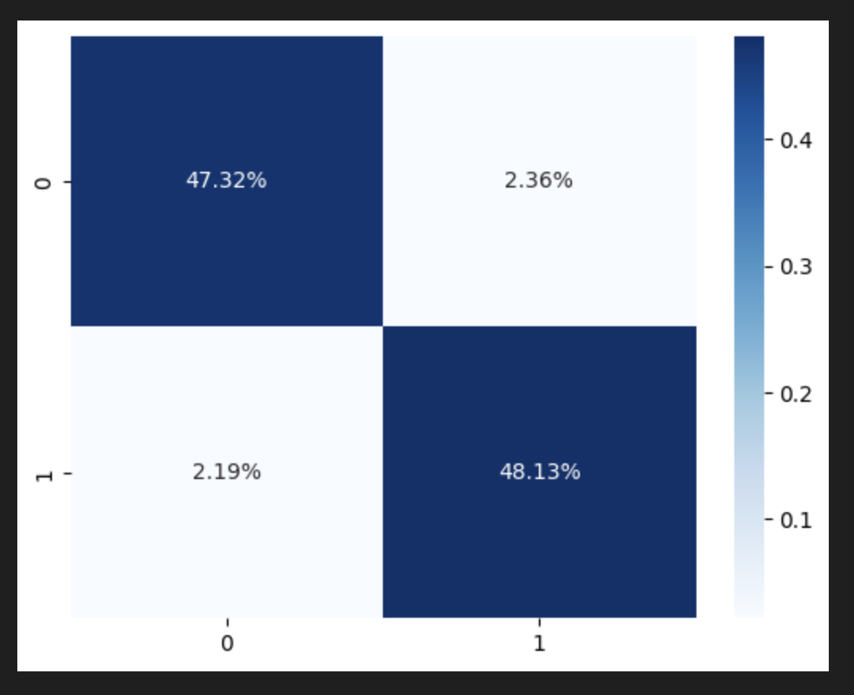
4.3 Model Comparison
4.3.8) SVM with Tf-IDF Vectorized Values

Slide 52
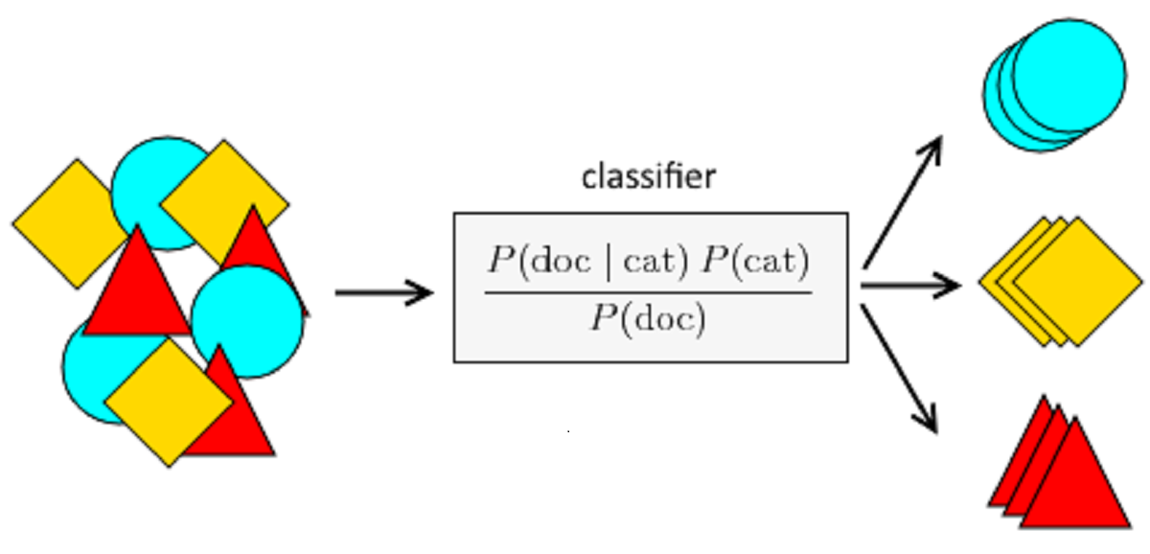
Naive Bayes
Probabilistic Approach: Naive Bayes is based on probabilistic principles, making it effective for modeling uncertainty and probability of an article being fake.
Efficiency: It is computationally efficient and can be trained on relatively small datasets, making it suitable for quick classification tasks.
Text Classification: Naive Bayes is particularly useful for text classification, as it can handle the high-dimensional and sparse nature of text data, which is common in news articles.
Notes:
Probabilistic Approach: Naive Bayes is based on probabilistic principles, making it effective for modeling uncertainty and probability of an article being fake.
Efficiency: It is computationally efficient and can be trained on relatively small datasets, making it suitable for quick classification tasks.
Text Classification: Naive Bayes is particularly useful for text classification, as it can handle the high-dimensional and sparse nature of text data, which is common in news articles.

Slide 53
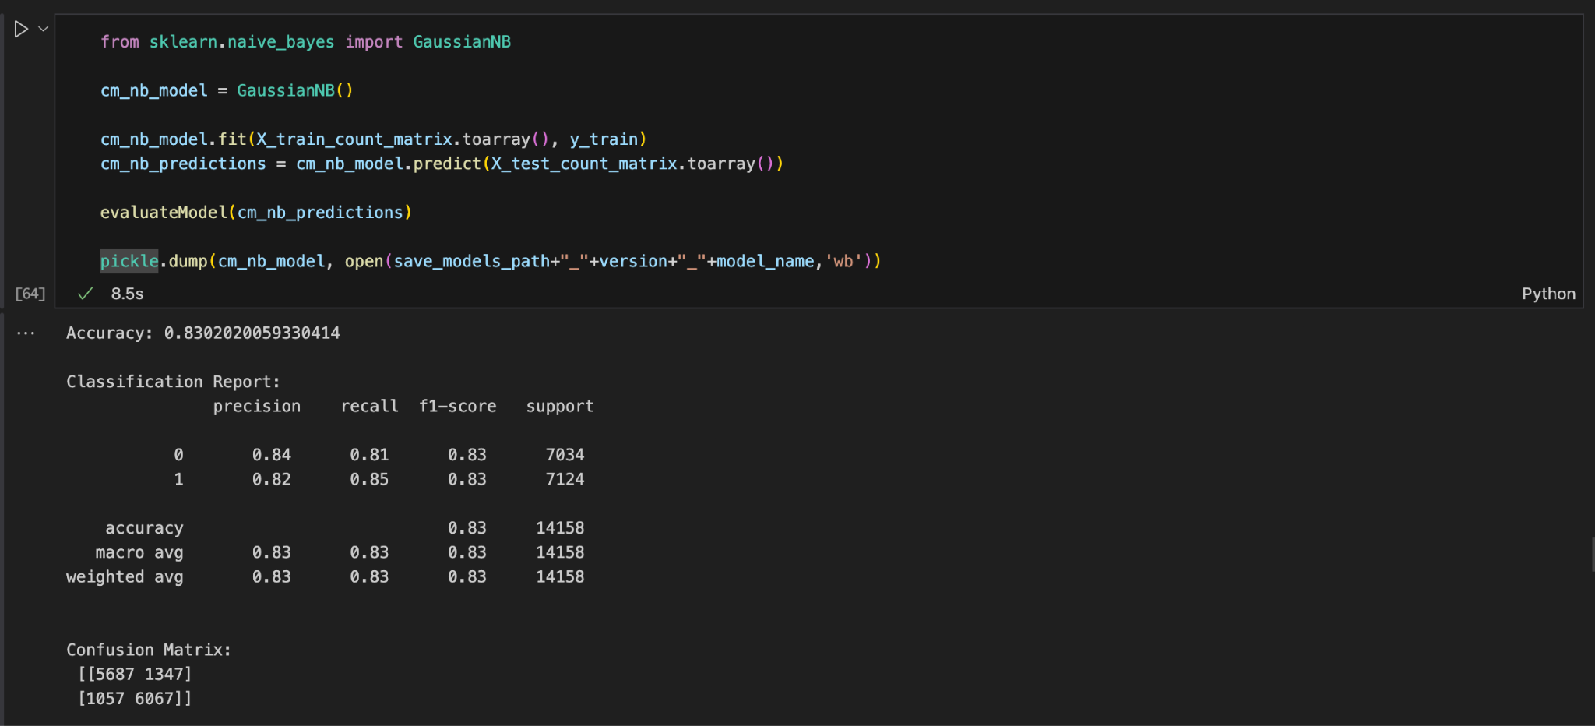
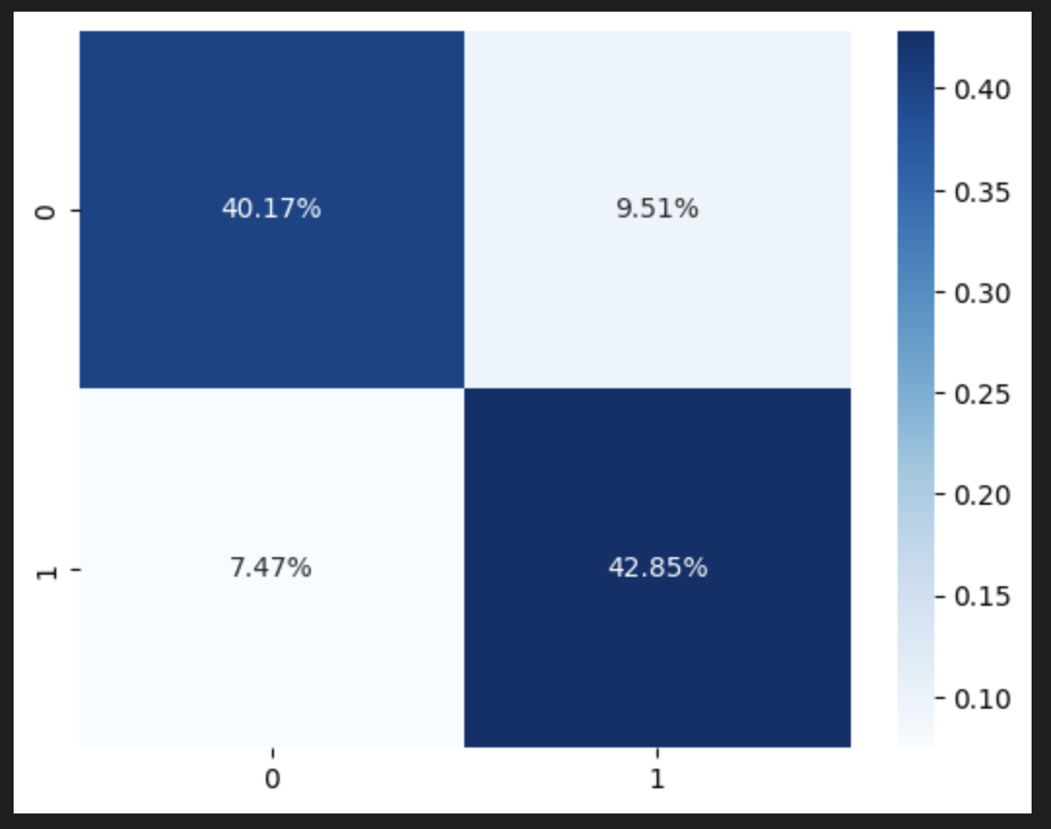
4.3 Model Comparison
4.3.9) Naive Bayes with Count Vectorized Values

Slide 54
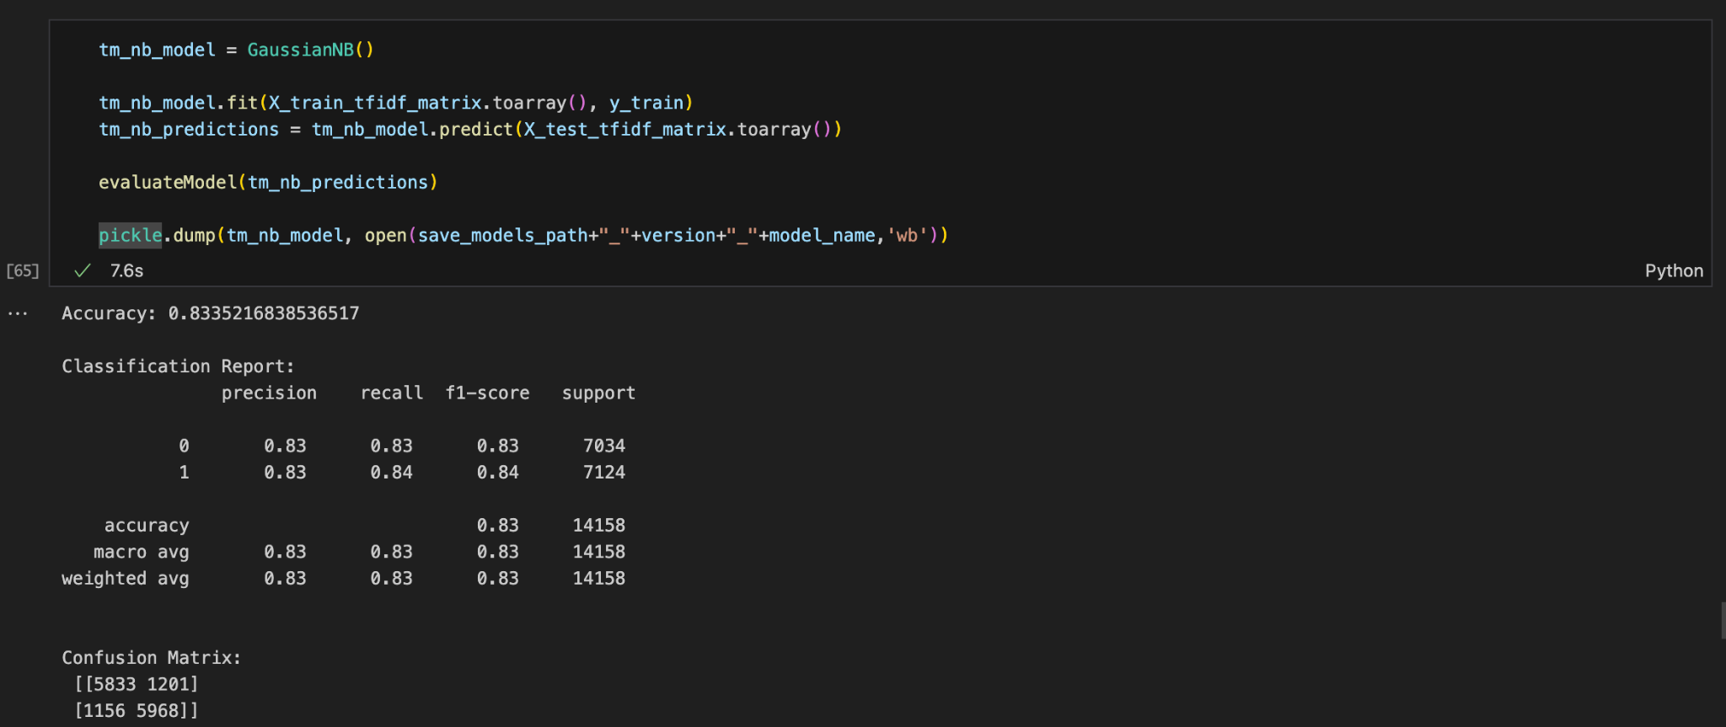
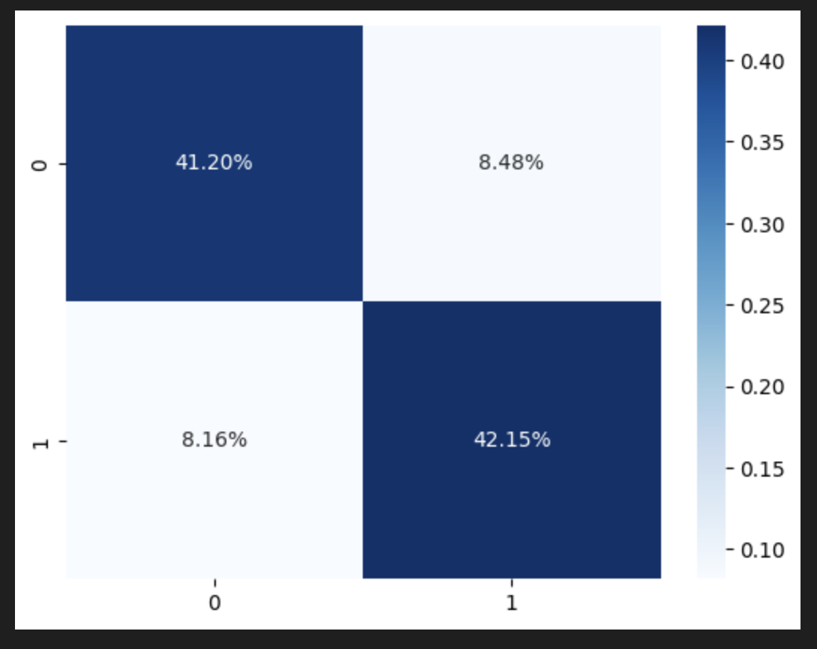
4.3 Model Comparison
4.3.10) Naive Bayes with Tf-IDF Vectorized Values

Slide 55
4.4 Model Evaluations Metrics
Count Vectorized
Models | Vectorizer Type | Accuracy | Precision | Recall | F1 Score
Logistic Regression | Count Vectorizer | 94.81% | 95% | 94% | 95%
Naive Bayes | Count Vectorizer | 83.02% | 83% | 83% | 83%
Decision Tree | Count Vectorizer | 93.26% | 93% | 93% | 93%
Random Forest | Count Vectorizer | 95.46% | 95% | 95% | 95%
Support Vector Machines | Count Vectorizer | 93.75% | 94% | 94% | 94%
Notes:
all the models perform very well, where Random forest had the highest accuracy of 95.46%, followed by logistic regression, svm, decision tree and naive bayes.

Slide 56
4.4 Model Evaluation Metrics
Tf-IDF Vectorized
Models | Vectorizer Type | Accuracy | Precision | Recall | F1 Score
Logistic Regression | TF-IDF Vectorizer | 94.44% | 94% | 94% | 94%
Naive Bayes | TF-IDF Vectorizer | 83.35% | 83% | 83% | 83%
Decision Tree | TF-IDF Vectorizer | 64.40% | 64% | 64% | 64%
Random Forest | TF-IDF Vectorizer | 95.31% | 95% | 95% | 95%
Support Vector Machines | TF-IDF Vectorizer | 95.45% | 95% | 95% | 95%
Notes:
When using the Tf-IDF vectorizer decision tree takes a huge fall from 93-64, the order changes to SVm followed by Random forest, Logistic regression, Naive bayes and Decision tree.

Slide 57
Thank you

